Slide 1
A Perspective on Facilitated Access to Custom IC Design in Leading-Edge CMOS Technology
Linton G. Salmon
EDA for HPC, Cloud and Server SoC Design Workshop
June 7, 2015
Approved for Public Release, Distribution Unlimited

Slide 2
Performance versus Development Cycle Times
Today you have to choose between performance and schedule/cost.
Example Data from representative DoD design
 | Qty | Power Req. | Dev. Cycle Time | Current Character
General Purpose Central Processor (CPU) | 28 | 1260W | ~6 months | Low performance at power Flexible Quick to implement
Field Programmable Gate Array (FPGA) | 4 | 120W | ~12 months | Low performance at power Flexible Moderately quick to implement
Custom Integrated Circuit (Custom IC) | 1 | 5W | ~24 months | High performance at power Relatively inflexible Slow to implement
Approved for Public Release, Distribution Unlimited

Slide 3
Performance versus Development Cycle Times
We need to change the design environment so we can have BOTH
We need to enable fast, flexible, and high performance custom ICs, bringing DoD system components up to speed with commercial technology and practices, but at a fraction of the effort even at the expense of increased area.
Approved for Public Release, Distribution Unlimited

Slide 4
Commercial and DoD Access to Leading-Edge CMOS Technology
Current Status
Commercial
Most volume at 28nm
Leading-edge products shipped at 20nm
Pilot production at 14nm
Driven by large companies
PDK widely available 2Q14
All leading-edge processes bulk
Leading-Edge technology available at multiple facilities
Turnaround time: 2-4 months (28nm)
DoD
Most volume at ≥ 130nm
Leading-edge products shipped at 90nm
Pilot production at 45nm
Driven by availability of infrastructure
~ 3 nodes behind 14nm
All leading-edge processes SOI
Leading-Edge technology confined to one at-risk facility, IBM–East Fishkill
Turnaround time: 9-12 months (32nm)
Need
Regular, dependable, fast leading-edge CMOS multiple-project runs for DoD
Full, supported commercial design enablement from foundry
Facilitated commercial component circuit (IP) access
A common methodology for DoD-specific IP generation/distribution
Greatly improved design methodology to sharply reduce design time/effort
Approved for Public Release, Distribution Unlimited

Slide 5
Why Use Leading Edge CMOS Custom Integrated Circuits?
5x – 10X
Custom
IC
General Purpose
GPU
10x – 1000x
General Process
CPU
FPGA
Custom IC
GP GPU
GP CPU
Intel CPU
130nm 90nm 65nm 40/45nm 28/32nm 20/22nm 14/16nm 10nm
Data from ISSCC papers 2010 – 2013
and "Energy Efficient Computing on Embedded and Mobile Devices” on nVidia.com
Approved for Public Release, Distribution Unlimited

Slide 6
Current Design Flow Takes so Long that it is Throttling DoD Access to Advanced Technology
DESIGN
PORT/ MIGRATE
REPOSITORY
28nm node example
Existing DoD custom IC product cycle time can take as long as 2.5 years.
60%: Design (most of which is verification)
40%: Fabrication (20%/fab spin)
130 Weeks
10 person team
~ 0.1B transistors
TODAY
Fab
#2
Fabrication
NRE
Fab
#1
39 Weeks
400 person team
~ 6.8B transistors
Verification
Design
NRE
Design
DoD Commercial
Design effort model derived from commercial and DoD sources
Notes:
CRAFT will solve the problem directly by reducing the amount of effort required to design a custom IC. The reduction will be achieved through leveraging modern programming techniques to the design process and by improving use of hierarchy to simplify design and reduce required verification.

Slide 7
Current Design Flow Takes so Long that it is Throttling DoD Access to Advanced Technology
28nm node example
Existing DoD custom IC product cycle time can take as long as 2.5 years.
60%: Design (most of which is verification)
40%: Fabrication (20%/fab spin)
Using “Object Oriented Design” and enhanced hierarchy, we want to achieve:
Reduction in design time by 10X through a strong reduction in verification time and removal of minimum area constraint
“First Time Right” design methods to eliminate the need for repeated fabrication runs.
Reduction in fabrication time to 2X commercial
130 Weeks
10 person team
~ 0.1B transistors
TODAY
Future
Fab
#2
Fabrication
NRE
Fab
#1
39 Weeks
400 person team
~ 6.8B transistors
30 Weeks
10 person team
~ 0.2B transistors
Verification
Design
NRE
Design
Data from plenary talk DAC–2013 by Ivo Bolsens (Xilinx)
and conversations with DoD contractors
DoD Commercial Need
Approved for Public Release, Distribution Unlimited
Design effort model derived from commercial and DoD sources

Slide 8
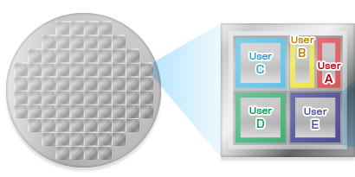
14nm is the Most Fabrication Cost-Effective Node for DoD
Custom IC Fab NRE* Costs
Fab NRE Costs per kgate
Multi Project Wafer (MPW)
Gate Density
It may be counter-intuitive, but for DoD, 14nm technology fabrication is CHEAPER per gate than 28nm technology and MUCH CHEAPER than 90nm technology, while providing greatly improved performance at power!
Fab NRE – Fabrication Non Recurring Engineering
(masks, wafers, set up)
Approved for Public Release, Distribution Unlimited
From International Business Strategies, 2013

Slide 9
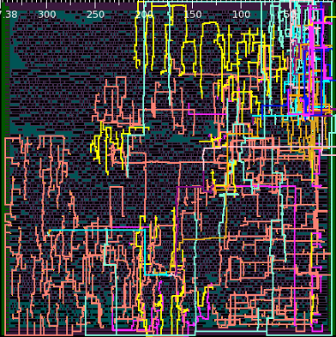
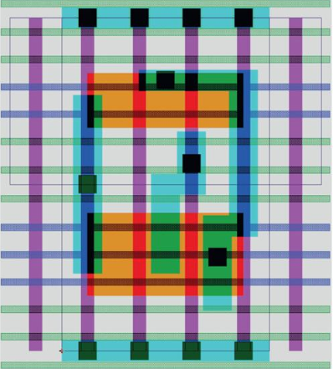
We Need a New Custom IC Design Flow
New Software Tool
Use of modern software engineering methods
Automated representation translation
Automated verification
Reduces effort required to port design to a 2nd source foundry
Distributed through a government IP repository
Raise Level of Abstraction
Use existing EDA tools
Higher level of hierarchy
Use of generators/constructs
Object Oriented Design (OOD) Flow
High level object oriented language -> Schematic
Place & Route
Layout Description
HL Code
OOD FLOW
SPICE
CELL/WIRE
OASIS
Existing
ASIC
Flow
HL Code
RTL
VHDL
SPICE
CELL/WIRE
OASIS
VERIFICATION
VERIFICATION
Approved for Public Release, Distribution Unlimited

Slide 10
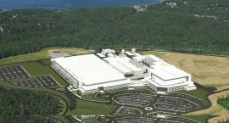
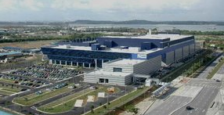
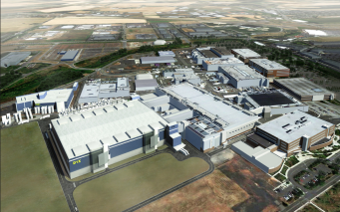
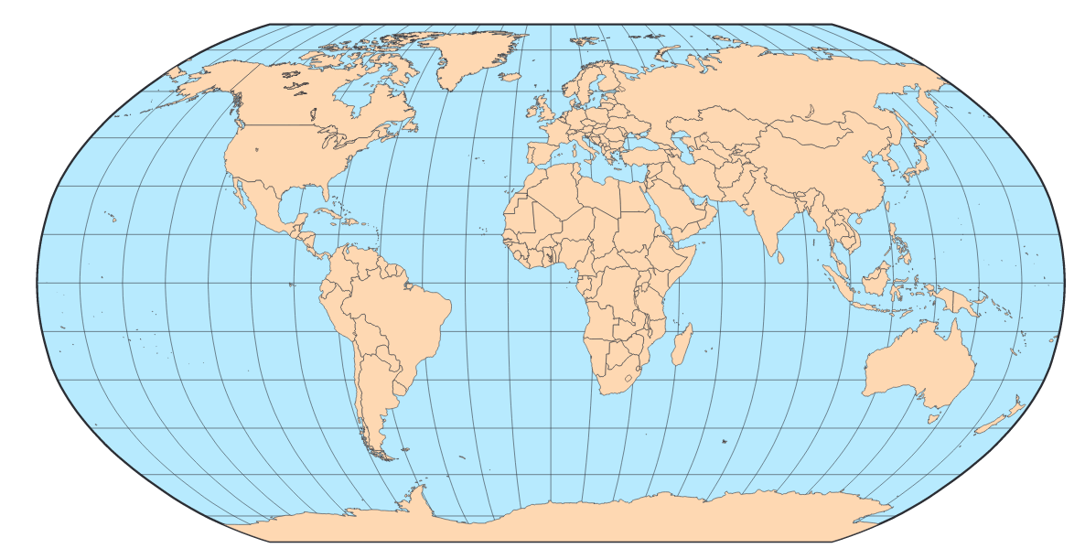
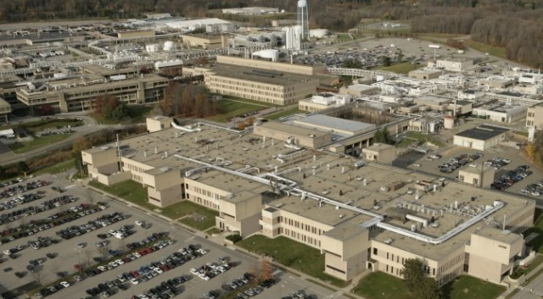
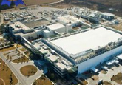
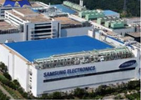
Only 4 Companies Provide FinFET CMOS Foundry Services
Global Foundries
TSMC
Intel
GlobalFoundries
TSMC
IBM
Intel
X
IBM
Samsung
Samsung
Samsung
Approved for Public Release, Distribution Unlimited

Slide 11
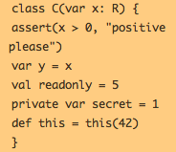
DoD Needs a Facilitated Flow to Port/Migrate DoD Custom IC Designs
Unique to Foundry/Node
Current ASIC
Design Flow
High Level description
Logical Descript’n
Gate Level Descript’n
Schematic Descript’n
Place & Route
Layout Descript’n
1,000,000s of elements
Unique to Foundry/Node
New
Design Flow
Object Oriented Design (OOD) Flow
High level object oriented language -> Transistor
Place & Route
Layout Descript’n
Compiled
100s of elements
Stored in gov’t repository
We need to sharply reduce the amount of “foundry unique” work required for a design.
Using an OOD Flow would reduce the effort to port designs to a new foundry
and/or to migrate them to a new technology node
Approved for Public Release, Distribution Unlimited

Slide 12
Potential Multi-Project Run Schedule
3Q15
1Q16
2Q17
3Q17
4Q17
1Q18
2Q18
3Q18
4Q18
1Q19
2Q19
3Q19
4Q19
4Q15
3Q16
2Q16
1Q17
4Q16
Release of PDK
Wafer fab and die reticulation/delivery
Wafer fab and die reticulation/delivery
Wafer fab and die reticulation/delivery
Wafer fab and die reticulation/delivery
Approach
16/14nm FinFET multi-project shuttle
Design submission date is planned for February, 2016
Cost will be approximately $50K/6mm² project
Turnaround time will be 6 months, GDS-In to die delivered to design teams
Training will be provided for design teams (face-to-face and web-based)
Aggregation and foundry-interface/design support will be provided
Approved for Public Release, Distribution Unlimited

Slide 13
Potential Shuttle Details
Process flow: FinFET process flow
Bulk FinFET transistors with dual gate oxide
SVT/LVT/1.8V IO transistor
BEOL stack: 9 levels of Cu wiring compatible with fundamental IP
Standard passive components (no deep trench capacitor)
Standard eFuse and anti-fuse blocks
HP SRAM bit cell
Tentative schedule
PDK available: August, 2015
Training: September - November, 2015
Firm shuttle commitment from users required: November, 2015
Design submission (GDS-In): February, 2016
Die back to users: August, 2016 (GDS-In + 6 months)
Aggregator/interface/training organization
All questions for the foundry will go through foundry interface
All GDS will be sent to aggregator
User cost will be ~ $50K/(3mmX2mm) project
Approved for Public Release, Distribution Unlimited

Slide 14
How Do I Sign Up/Ask Questions?
Indicate interest by sending an email to: caroline.rudolph.ctr@darpa.mil
Please provide the following information:
User point of contact
User organization
Brief description of the purpose for the project(s)
Associated US Government agency
Area required (in units of 2mmX3mm blocks)
Any questions you may have
Approved for Public Release, Distribution Unlimited

Slide 15
DARPA Wants to “Ride the Wave” to Exciting Places!
The “Wave” (Smartphone market example)
Global consumers
> $265B market (global revenue in 2013)*
Drives leading-edge CMOS technology
Requires digital, analog, and RF advances
Burdened by large SoC design investments
Pays for large, production wafer volumes
“Generates” the power of the wave
* Statista.com website
Frank Kovalchek from Anchorage, Alaska, USA
The “Surfer” (DoD system development/deployment)
Global suppliers
< $1.5B market (US Government business in 2013)**
Utilizes commercially-driven CMOS technology
Leverages digital, analog, and RF advances
Drives new, boutique design/architecture approach
Pays for low wafer volumes
“Utilizes” the power of the wave
** IC Insights “IC Market Drivers 2014 Update”
U.S. Marine Corps Photo
Approved for Public Release, Distribution Unlimited

Slide 16
Approved for Public Release, Distribution Unlimited

