Slide 1
System On Chip Devices for High Performance Computing Design Automation Conference 2015 System On Chip Workshop
Noel Wheeler (nwheeler@lps.umd.edu)
Advanced Computer Systems Research Program (ACS)
Laboratory for Physical Sciences
University of Maryland, Catonsville MD

Slide 2
Research Metrics
Modeling, Simulation, and Emulation
Computer Architecture and Engineering
Mission Proxies
Energy
$
Productivity
Resilience

Slide 3
HPC Community Challenges?
Just a few of the problems
Conventional Technology, for example CMOS
Architectural obstacles, such as “Memory Walls”
And of course, Moore’s Law
Computation problems are evolving
Data is becoming “bigger” and increasingly complex

Slide 4
HPC State of the Art
Very capable processors
Many/Multicore processors
Clustered computer systems
Specialized Processors/Logic
ASIC/FPGA devices
Exotic technologies

Slide 5
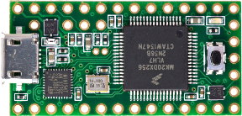
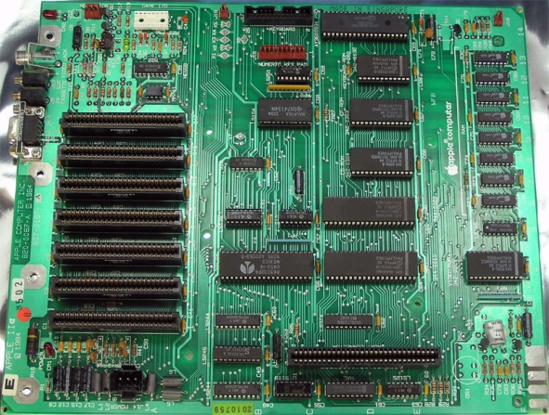
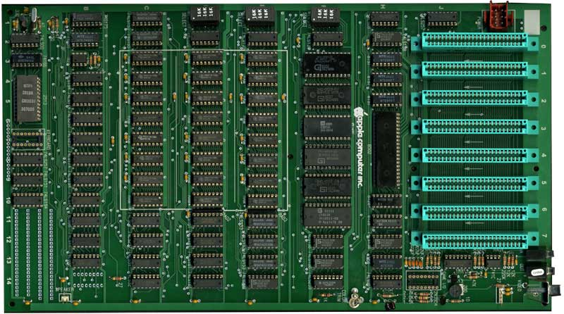
SOC’s are interesting!
SOC’s are not a new idea
Chipsets,
Embedded systems
Hybrid Memory Cube

Slide 6
SOC’s of Today
We are surrounded by SOC devices
Consider the cell phone industry…
Recall our “four metrics”
Consumers area always demanding more
Industry that is motivated to deliver!

Slide 7
Moving Toward a HPC-SOC
Most of the technology exists to do this already
Understanding the recipe for an SOC to best serve the HPC community
Modeling/Simulation tools
SOC’s S/N 1-1000 will be expensive
SOC’s S/N 1000+ are probably going to be a lot cheaper!
Getting the design as right as possible is a good idea

Slide 8
Other challenges…
Algorithms
Development tools
Software models
Compilers
Operating systems
PACT Workshop – October18-21 2015

Slide 9
Some thoughts
OpenHPC
Open source technologies
Research funding opportunities

