Slide 1
SoC Design Methodology for
Exascale Computing
Shekhar Borkar
Intel Corp.
June 7, 2015
This research was, in part, funded by the U.S. Government, DOE and DARPA. The views and conclusions contained in this document are those of the authors and should not be interpreted as representing the official policies, either expressed or implied, of the U.S. Government.

Slide 2
Outline
Exascale motivation & challenges
Future Exascale straw-man system design
  Compute
  Memory
  Interconnect
Design challenges and solutions
Choice of process technology
SoC Challenges

Slide 3
From Giga to Exa, via Tera & Peta
1.5x from transistor
670x from parallelism
Exa
Peta
8x from transistor
128x from parallelism
Tera
32x from transistor
32x from parallelism
Giga
System performance from parallelism

Slide 4
Where is the Energy Consumed?
Teraflop system today
Decode and control
Address translations…
Power supply losses
Bloated with inefficient
architectural features
600W
~1KW
10TB disk @ 1TB/disk @10W
100W
Disk
Goal
100W
100pJ com per FLOP
Com
5W
~20W
0.1B/FLOP @ 1.5nJ per Byte
150W
~3W
Memory
~5W
50W
2W
50pJ per FLOP
Compute
5W

Slide 5


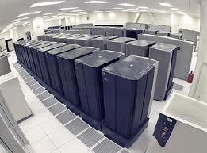

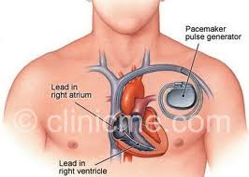


The UHPC* Challenge
*DARPA, Ubiquitous HPC Program
20W, Tera
20MW, Exa
20KW, Peta
20 pJ/Operation
2W, 100 Giga
20 μW, Mega
20 mW, Giga

Slide 6
Top Exascale Challenges
System Power & Energy
New, efficient, memory subsystem
Extreme parallelism, data locality, gentle-slope programmability
New execution model comprehending self awareness with introspection
Resiliency to provide system reliability
System efficiency & cost

Slide 7
Exascale HW Design Challenges
1. NTV Logic & Memory for low energy
4. Instrumentation for introspection
Break the Vmin barrier
FPU, logic & latches
Register Files,
SRAM
Energy measurement
Performance feedback
Ambient conditions
2. Coping with variations due to NTV
5. Hierarchical, heterogeneous IC
Freq degradation
Variation in performance
Functionality loss
Busses
X Bars
Circuit & Packet Switched
3. Fine grain power management
6. Overhaul memory subsystem
Voltage Regulator
Buck or Switched Cap
Power gating
Frequency control

Slide 8
Exascale SW Challenges
1. Extreme parallelism O(billion)
4. Self awareness
Observation based
Monitor, continuously adapt
Objective function based runtime optimization
Programming model
Data locality
Legacy compatibility
2. Programming model & system
5. Challenge applications
Data flow inspired
Gentle slope programming
(Productivity to high performance)
New algorithms
Locality friendly
Immunity to tapered BW
3. New execution model
6. System level resiliency research
Event driven
Asynchronous
Dynamic scheduling
Runtime system

Slide 9
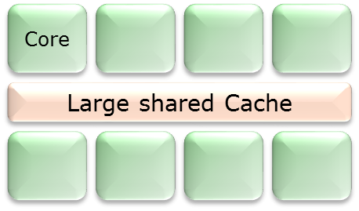
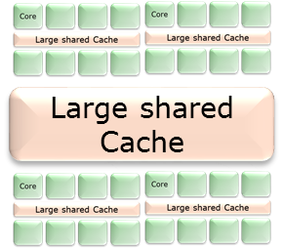
Exascale SoC Processor Straw-man
Block
Cluster
Simple Core
Core
I$
D$ (64KB)
Large shared Cache/Mem
Large shared Cache/Mem
Dec
RF
FPMAC
SoC
SoC Targets (5 nm)
Die Size | mm | ~25
Frequency | GHz | >2
Cores |  | ~4096
FP Perf | Tera-Flops | >16
Power | Watts | < 100
Energy Efficiency | pJ/FLOP | 4-6
 | GF/Watt | > 200
IO (PCIe)
Interconnect Fabric
Large shared Cache/Mem
Interconnect Fabric
Mem Controller

Slide 10
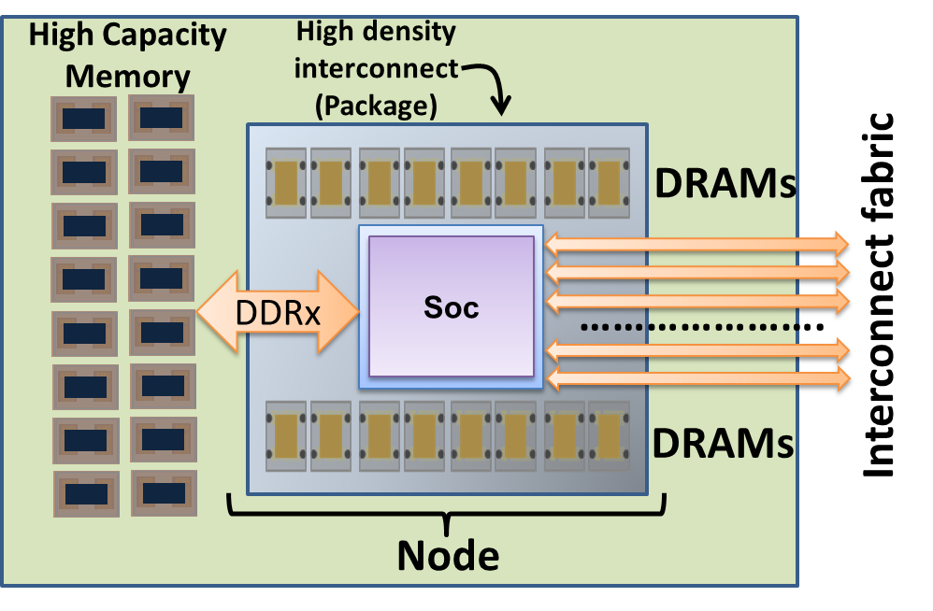
Node
High performance, low power
~1 TB
LPDDR
LPDDR
4 TB
LPDDR
......
LPDDR
3D
3D
DDRx
......
1 TB/s
Total BW
DDRx
SoC
High capacity, low cost
......
DDRx
......
DDRx
IC Fabric
Processor Node

Slide 11
Interconnect Switch Straw-man
Optical PHY
Electrical PHY
Electrical PHY
Optical PHY
Data Buffer
Data Buffer
Arbitration Logic
Electrical PHY
Data Buffer
Data Buffer
Switching Fabric
Electrical PHY
Arbitration Logic
Arbitration Logic
Local Electrical Switch Network
Electrical PHY
Data Buffer
Data Buffer
Electrical PHY
Arbitration Logic
Optical PHY
Data Buffer
Data Buffer
Optical PHY
Electrical PHY
Electrical PHY

Slide 12
On-die Data Movement vs Compute
Compute energy
On die IC energy/mm
60%
6X
Interconnect energy (per mm) reduces slower than compute
On-die data movement energy will start to dominate
Notes:
Having looked at energy efficiency of the compute, let’s now focus on the communication aspects.
The graph to the left compares energy per operation of a compute operation over successive generation of technologies, and compares against energy of moving a bit over on-die interconnect by say one mm.
Notice that the interconnect energy reduces much slower than the compute energy. Therefore, interconnect related energy will start dominating in the future designs, necessitating restricting data movement.
Off-die interconnect energy and bandwidth is shown to the right. The energy is reducing, and the bandwidth is increasing, but probably not at the rate desired to support compute.
Also notice that there is a big gap between what is reported in the research papers in terms of energy efficiency and bandwidth, vs what is actually realized in production.
We need to pay attention to both on-die as well as off-die communication much more than in the past.

Slide 13
Interconnect vs Switch Energy
Repeated wire delay
Wire energy
Switch delay
Switch energy
Switch energy
With scaling

Slide 14
Interconnect Structures
Buses over short distance
Shared memory
Cross Bar Switch
Shared bus
Multi-ported Memory
X-Bar
1 to 10 fJ/bit
0 to 5mm
Limited scalability
10 to 100 fJ/bit
1 to 5mm
Limited scalability
0.1 to 1pJ/bit
2 to 10mm
Moderate scalability
Packet Switched Network
Board
Cabinet
System
1 to 3pJ/bit
>5 mm, scalable
Hierarchy & Heterogeneity

Slide 15
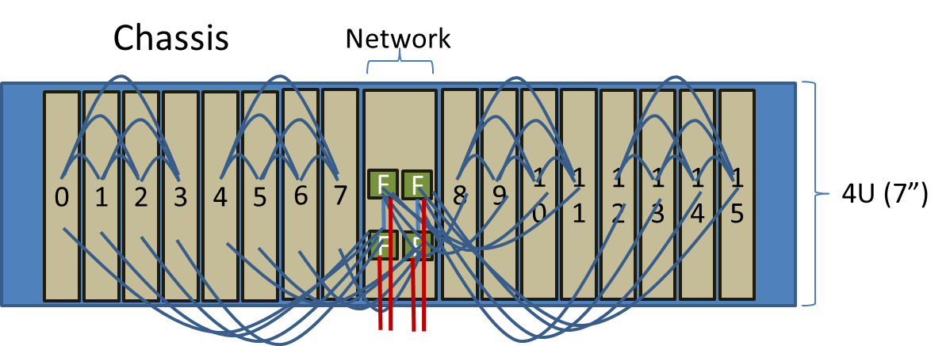
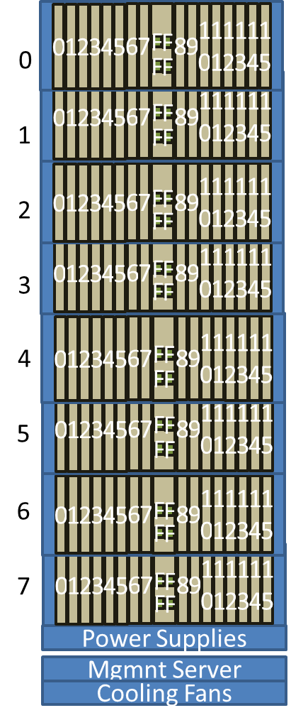
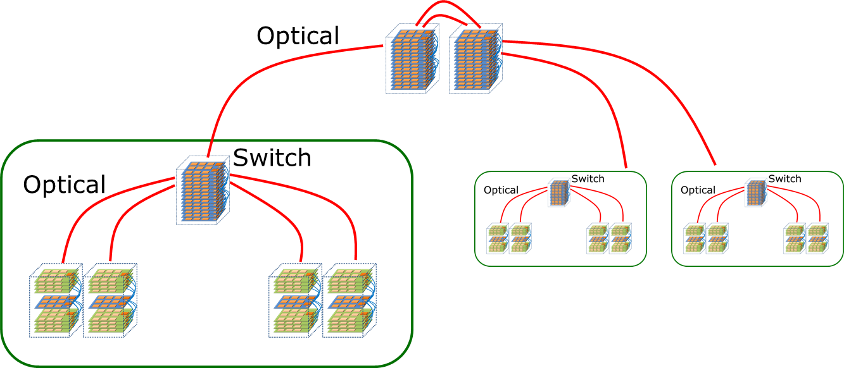
Exascale HW System

Slide 16
Bandwidth Tapering
Naïve, 4X
Severe
Intelligent BW tapering is necessary

Slide 17
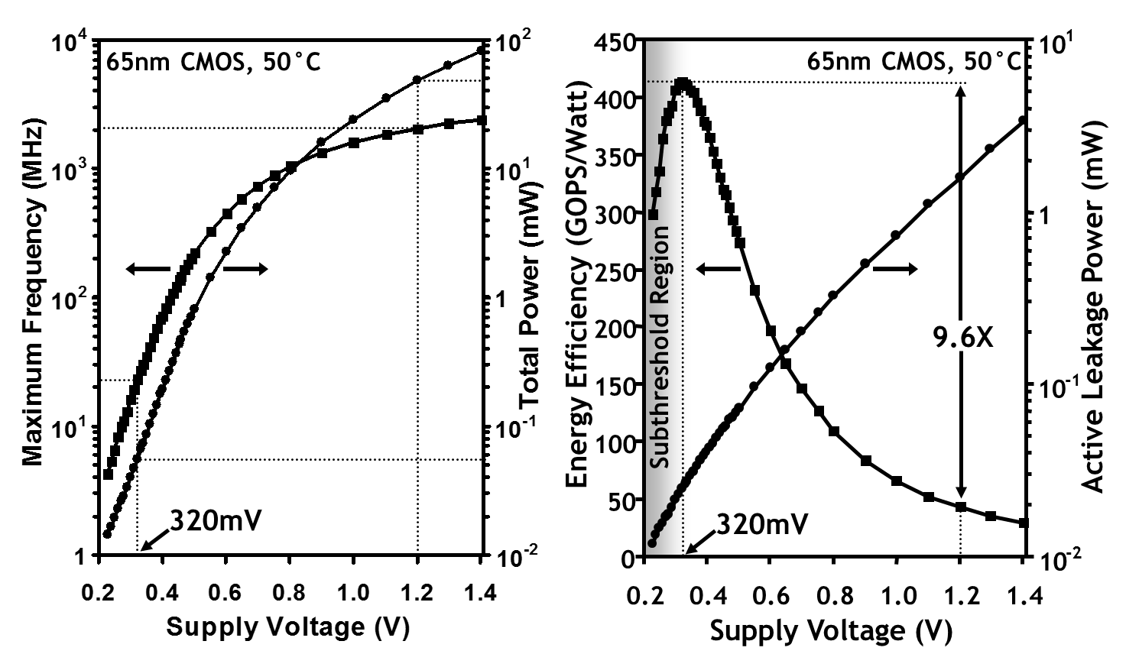
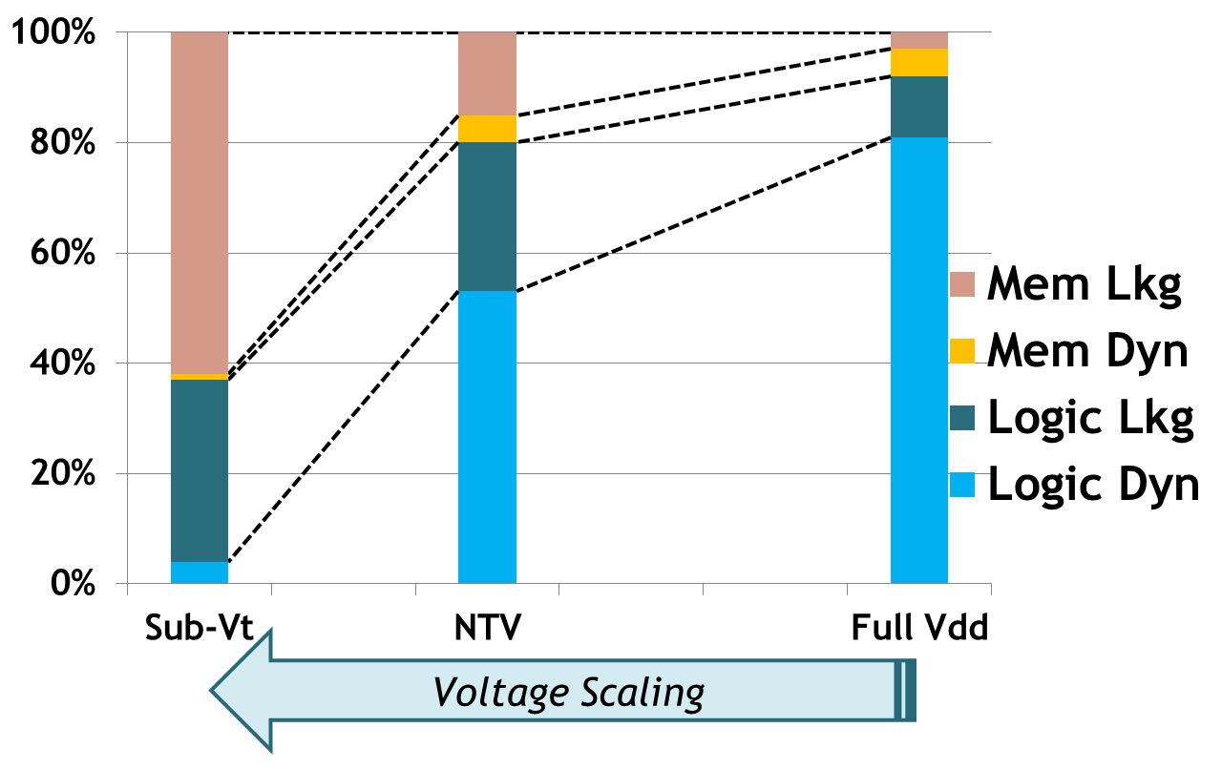
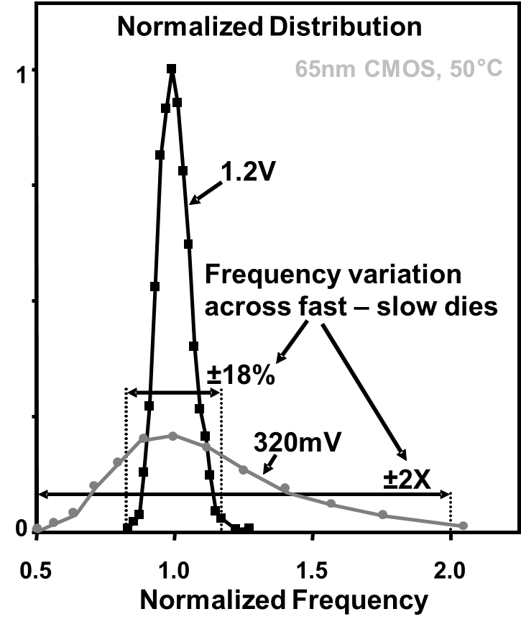
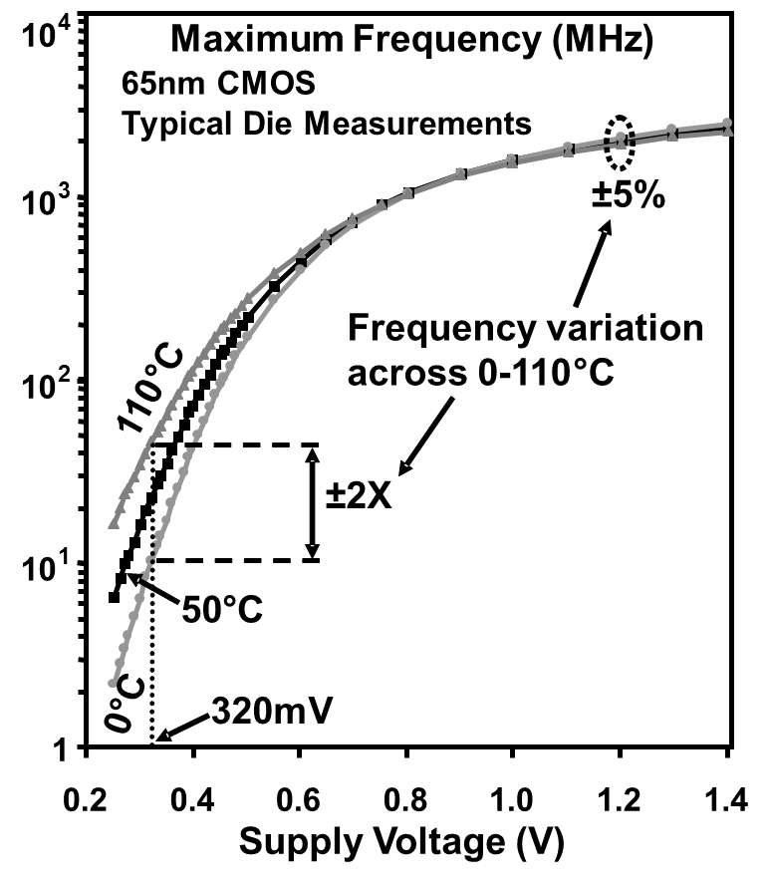
NTV Operation for Energy Efficiency
10X increase in Energy Efficiency
Leakage power dominates
Variations become worse
Die to die frequency
Across temperature
H. Kaul et al, 16.6: A 320mV 56μW 411GOPS/Watt Ultra-Low-Voltage Motion-Estimation Accelerator in 65nm CMOS ISSCC 2008
H. Kaul et al, “Near-Threshold Voltage (NTV) Design—Opportunities and Challenges”, DAC, 2012

Slide 18
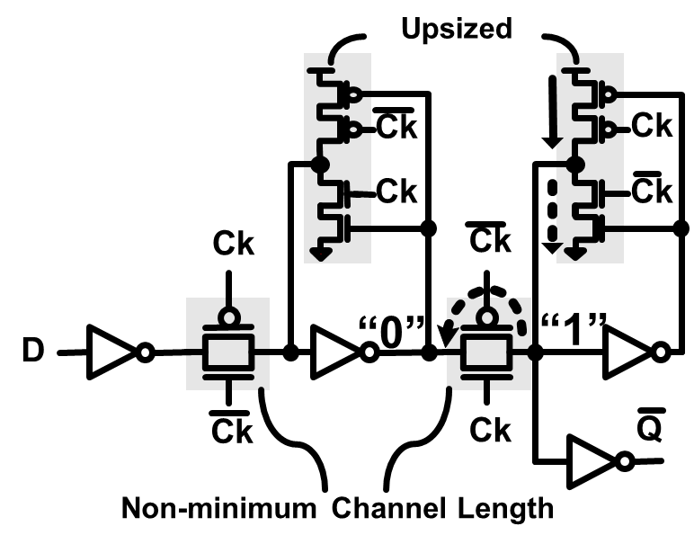
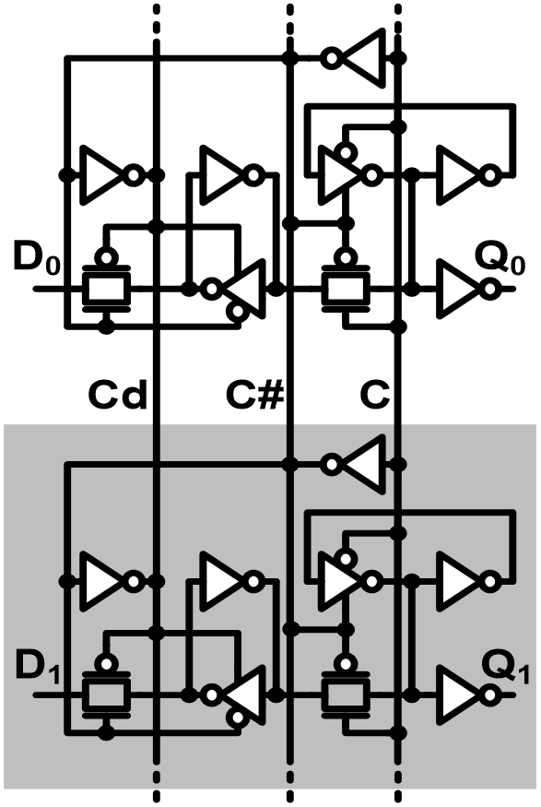
NTV Design Considerations (1)
Conventional dual-ended write RF cell
NTV friendly Flip-Flop
NTV friendly Vector Flip-Flop
NTV friendly, dual-ended transmission gate RF cell
H. Kaul et al, “Near-Threshold Voltage (NTV) Design—Opportunities and Challenges”, DAC, 2012

Slide 19
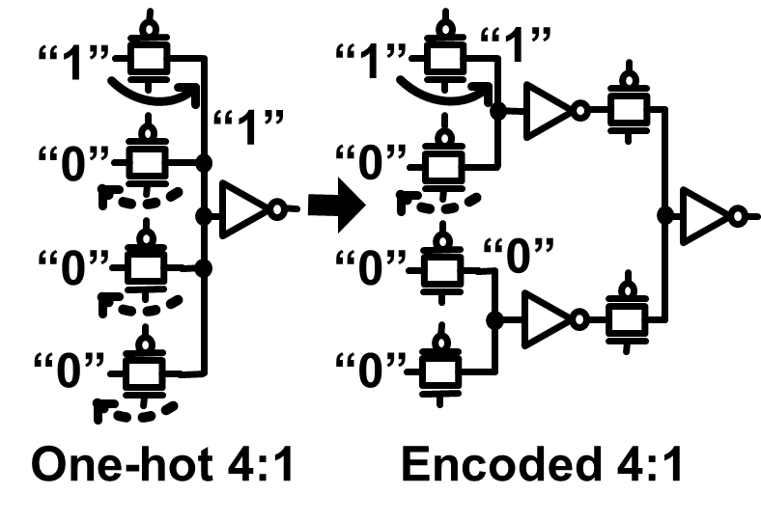
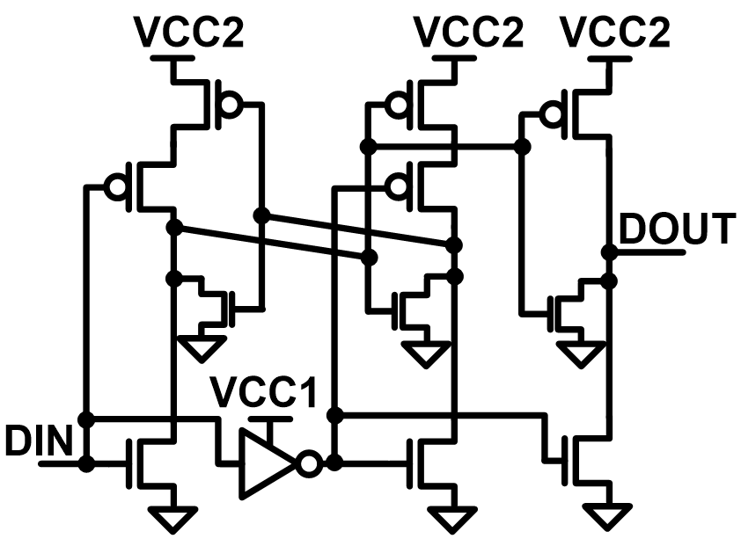
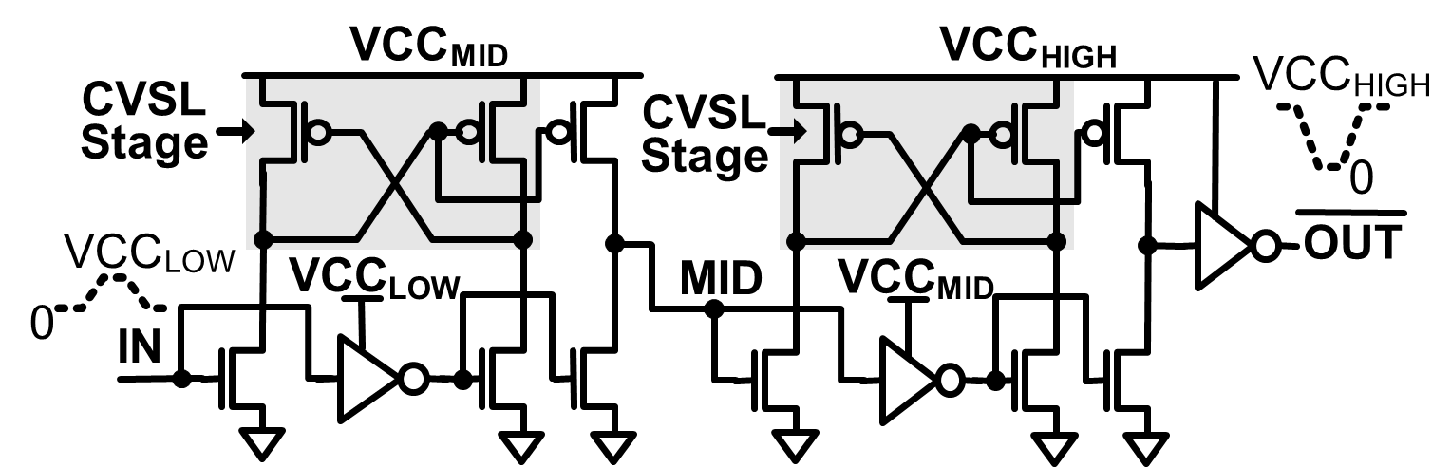
NTV Design Considerations (2)
NTV friendly multiplexer
Ultra-low voltage, split-output level shifter
Two-stage, cascaded split-output level shifter

Slide 20
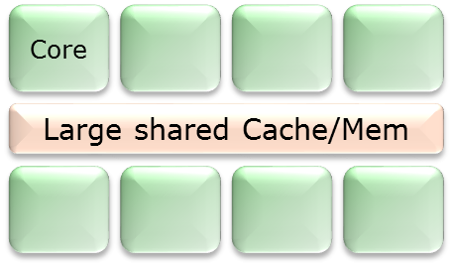
Integration of IP Blocks
Vdd
Power Enable#
Integrated
Voltage
Regulator
&
Control
Clock
L
Vout
Enable
Power Enable
Synthesizing clock gating
Integrated voltage regulators
Synthesizing power gating
Enable DVFS and NTV operation
Other traditional IP blocks:
Accelerators, Memory controller, PCIe, …etc.

Slide 21
Choice of Technology
22 nm SoC Technology
30% drop
100X drop
C.-H. Jan et al, “A 22nm SoC Platform Technology Featuring 3-D Tri-Gate and High-k/Metal Gate, Optimized for Ultra-Low-Power, High-Performance and High-Density SoC Applications”, IEDM 2012

Slide 22
SoC Design Challenges
Challenge | Potential Solutions
1,000’s or cores Large die WD & DD Variations | Variation tolerance Dynamic, system level adaptation
Voltage scaling to NTV | New standard cell library?
Data movement dominates | Interconnect optimization
Multi-ported, various sizes of RF and memories | Memory and RF compilers
Integration of custom and off-the-shelf IP blocks | Soft IP, not hard IP
Complexity | Formal verification
Silicon cost | Architectural simplicity
Design for system efficiency | System level optimization tools
Process technology | HP vs LP—judicious choice

