Slide 1
SoC for HPC Workshop Overview
Computer Architecture Laboratory
John Shalf and James Ang
David Donofrio & Farzad Fatolli Fard
LBL/SNL Computer Architecture Laboratory
DAC 2015
San Francisco, California
June 7, 2015

Slide 2
Workshop Series Goals
The HPC-SoC workshop will focus on semi-custom, application-targeted designs, and server processing for HPC and data-centers.
The goal is to develop a strategy for a robust open ecosystem for SoC designs that serve the needs of energy efficient HPC applications for multiple government agencies

Slide 3
Steering Committee
Larry Bergman (NASA/JPL)
William Harrod (DOE/SC)
Jon Hiller (STA representing DARPA/MTO)
Thuc Hoang (DOE/NNSA)
Hong Jiang (NSF)
Noel Wheeler (LPS/ACS)
http://www.socforhpc.org
http://www.cal-design.org/

Slide 4
Workshop Series
SOC for HPC Workshop (Denver):
  August 26, 2014
DAC 2015 Design Automation for HPC and Server Class SOCs (San Francisco)
  June 7, 2015
PACT 2015 Software Tools and Techniques for HPC, Clouds, and Server Class SOCs (San Francisco):
  October 18-21, 2015

Slide 5
Background

Slide 6
HPC Market Overview
Mark Seager LLNL
High End Systems (>$1M)‏
Most/all Top 500 systems
Custom SW & ISV apps
Technology risk takers & early adopters
Capability Computing
IDC:
2005: $2.1B
2010: $2.5B
Volume Market
Mainly capacity; <~150 nodes
Mostly clusters; >50% & growing
Higher % of ISV apps
Fast growth from commercial HPC; Oil &Gas, Financial services, Pharma, Aerospace, etc.
IDC:
2005: $7.1B
2010: $11.7B
Capacity Computing
IDC Segment System Size
2005
2010
CAGR
$250K-$1M
$1.9B
$3.4B
11.8%
$50K-$250K
$2.9B
$4.9B
10.7%
Total market >$10.0B in 2006
Forecast >$15.5B in 2011
0-$50K
$2.2B
$3.4B
9.6%
HPC is built with of pyramid investment model

Slide 7
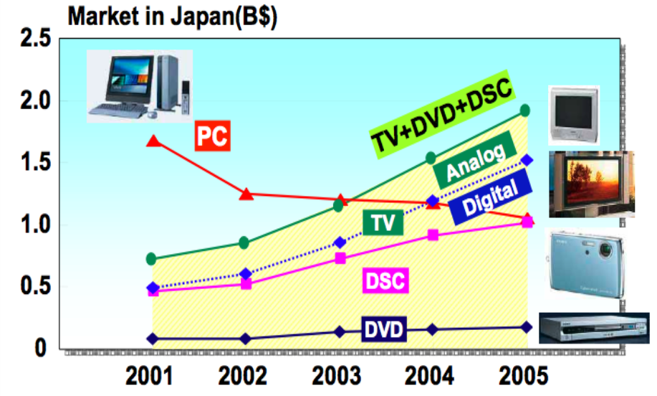
Technology Investment Trends
Image from Tsugio Makimoto: ISC2006
1990s - R&D computing hardware dominated by COTS
  Had to learn how to use COTS clusters for HPC
  Business moved from Mainframe to Cloud
2010 - R&D investments moving rapidly to consumer electronics/ embedded processing
  Must learn how to leverage embedded/consumer processor technology for future HPC and Cloud systems
Notes:
We’re going through the same phase that we went through in the 90’s.
So are we going to buy a bunch of A8 chips from an iPhone and lash those puppys together to make a supercomputer?
Hell no!

Slide 8
IDC 2010 Market Study
Embedded market is too large to ignore

Slide 9
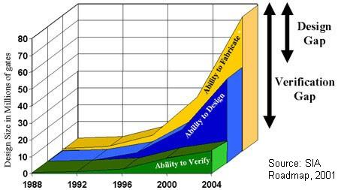
Design Verification Costs
Design complexity scales linearly (if you are optimistic)
Verification complexity grows exponentially
Motivates use of pre-verified commodity IP blocks
  Verification costs shared by broader market
Notes:
We can put more transistors, but it is getting more and more difficult
Verification becomes the main component in the bill
Its only getting worse with time
But IC vendors care about money so… What’s the money consequences?

Slide 10
Energy Efficient Hardware Building Blocks
Seymour Cray 1977: “Don’t put anything into
a supercomputer that isn’t necessary.”
Mark Horowitz 2007: “Years of research in low-power embedded computing have shown only one design technique to reduce power: reduce waste.”

Slide 11
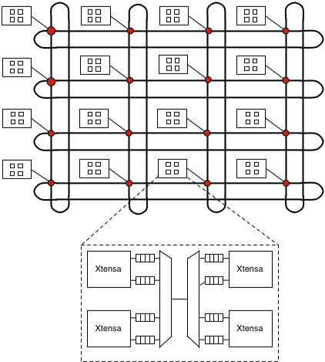
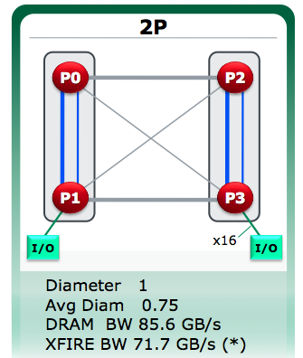
Building an SoC from IP Logic Blocks
Its legos with a some extra integration and verification cost
Processor Core (ARM, Tensilica, MIPS deriv)
With extra “options” like DP FPU, ECC
IP license cost $150k-$500k
NoC Fabric: (Arteris, Denali, other OMAP-4)
IP License cost: $200k-$350k
memctl
Memory
DDR3 1600 memory controller (Denali / Cadence, SiCreations)
+ Phy and Programmable PLL
IP License: $250-$350k
DRAM
memctl
Memory
PCIe
FLASH ctl
IB or GigE
IB or GigE
DRAM
PCIe Gen3 Root complex
IP License: $250k
With Marty Deneroff
Integrated FLASH Controller
IP License: $150k
10GigE or IB DDR 4x Channel
IP License: $150k-$250k

Slide 12
Redefining “commodity”
Must use “commodity” technology to build cost-effective design
The primary cost of a chip is development of the intellectual property
    Mask and fab typically 10% of NRE in embedded
    Design and verification dominate costs
    SoC’s for high perf. consumer electronics is vibrant market for IP/circuit-design (pre-verified, place & route)
    Redefine your notion of “commodity”!
The ‘chip’ is not the commodity…
The stuff you put on the chip is the commodity

Slide 13
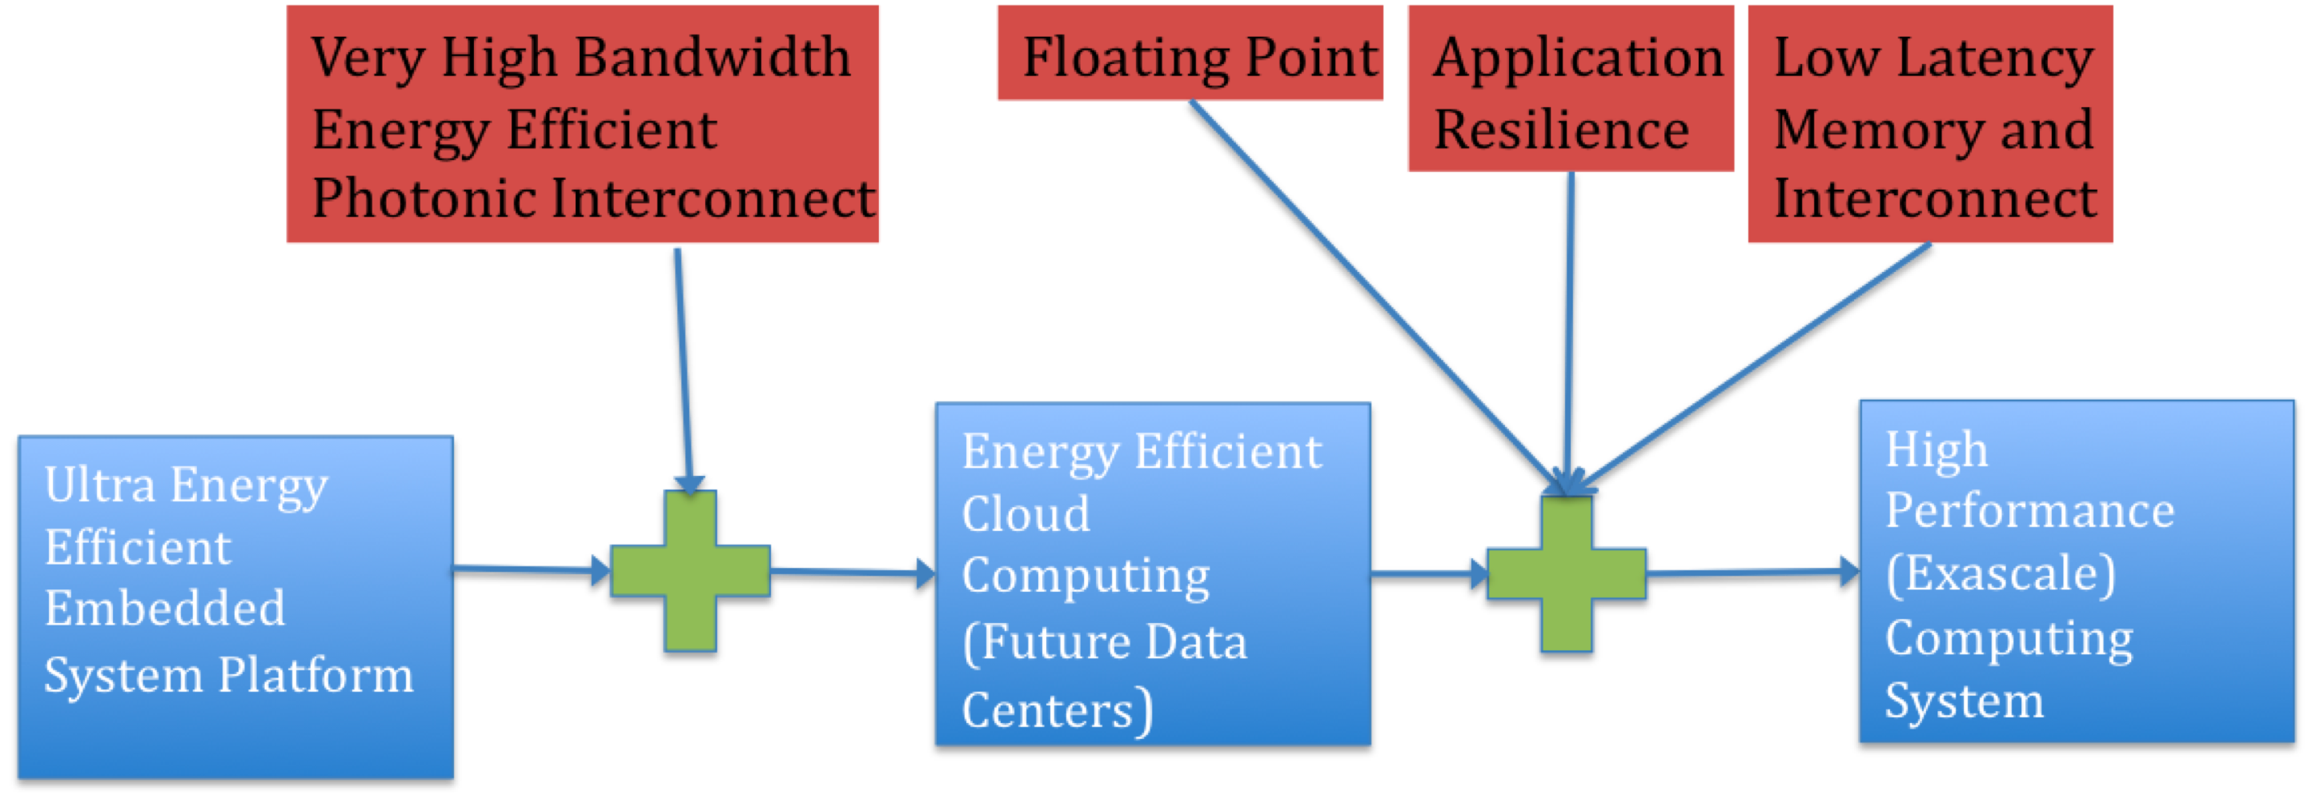

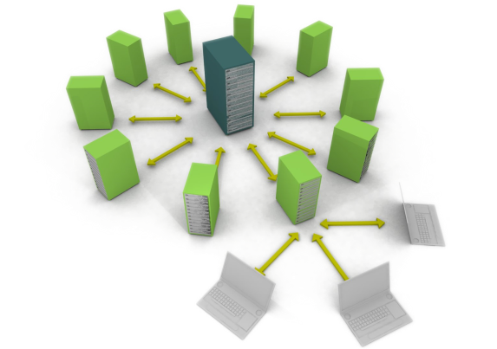
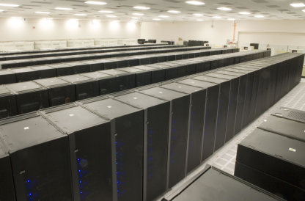
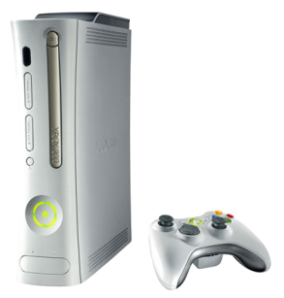
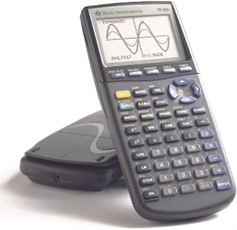
Technology Continuity for
A Sustainable Hardware Ecosystem
With Keren Bergman (Columbia LRL)

Slide 14
SoC for HPC Workshop Overview
Computer Architecture Laboratory
John Shalf and James Ang
LBL/SNL Computer Architecture Laboratory
Denver, Colorado
August 26, 2014

Slide 15
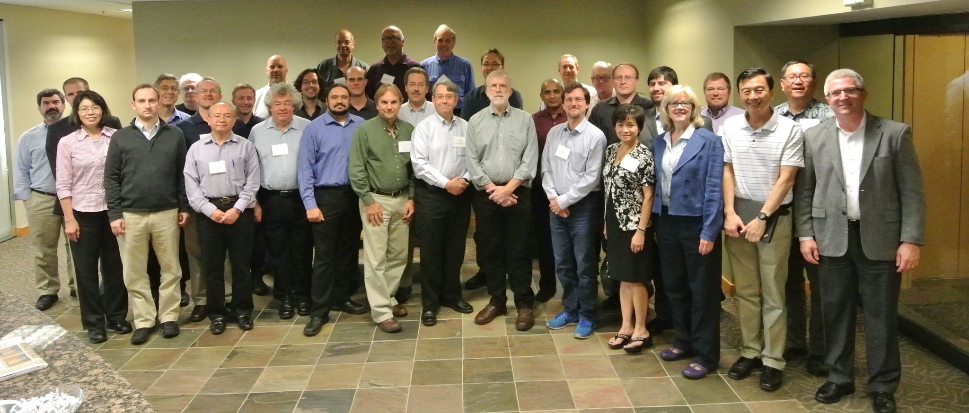
Denver Workshop Participants

Slide 16
SoC for HPC Workshop Scope
State of the Art: What can be done to leverage commodity embedded IP components, tools, and design methodologies to create HPC-targeted designs.
Technology Inventory and Requirements Analysis: Survey the currently available IP building blocks and identify where gaps exist in current IP circuit technologies and design tools that will be crucial to HPC and datacenter-targeted SoC ASICs.
Software Infrastructure: What will be required of our software environment to take full advantage of a rapidly evolving SoC designs. What would need to change in our software engineering practices keep up with a more flexible and rapidly evolving hardware design target?
Simulation/Modeling: SoC poses challenges to existing monolithic CPU-centric simulation environments that were originally designed for cell-phone scale systems. What new technologies will be required to bring the kind of design agility to the HPC-SoC design space that is currently relied upon for competitive consumer electronic designs.
OpenSoC: What open technologies, tools, and open-source gate-ware are available to engage the academic and research community involved in exploring the design space for high performance SoCs.

Slide 17
Desired Workshop Outcomes (Denver)
Plot a roadmap for creating an embedded component ecosystem for HPC
  That leverages the enormous investments taking place in the embedded/consumer electronics market
  Is effective for HPC
Identify opportunities and weaknesses in the SoC strategy
  What is the performance & market potential of this approach.
  What is missing from the commodity IP component market
  Where will market forces NOT deliver the kinds of components required for effective Server/HPC/WSC SoC designs
Where should government agencies (DOE, DOD, DARPA, NASA, NSF) concentrate their R&D expenditures to open up an alternative path for technology innovation
Write a report documenting our findings

Slide 18
SOC2014 Report: Conclusions
SOC technologies for HPC are extremely promising
  Not just “a path forward” (perhaps “The” path forward)
  Scope should be expanded to include clouds and high performance embedded
Risk #1: Hardware and Design Automation
  Most SOC design automation tools targeted at low-performance SOCs and microcontrollers
  Need for interface compatibility (more lego-like assembly)
Risk #2: Software Environment
  HPC and Cloud SW stack for SOC is very immature
  Software stack (currently) is inflexible and brittle

Slide 19
SOC2014 Report: Conclusions
SOC technologies for HPC are extremely promising
  Not just “a path forward” (perhaps “The” path forward)
  Scope should be expanded to include clouds and high performance embedded
Risk #1: Hardware and Design Automation
  Most SOC design automation tools targeted at low-performance SOCs and microcontrollers
  Need for interface compatibility (more lego-like assembly)
Risk #2: Software Environment
  HPC and Cloud SW stack for SOC is very immature
  Software stack (currently) is inflexible and brittle
DAC15
PACT15

Slide 20
Updated Schedule http://www.socforhpc.org/?page_id=167

Slide 21
Updated Schedule http://www.socforhpc.org/?page_id=167

Slide 22
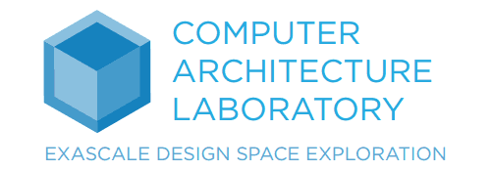
End
Computer Architecture Laboratory
LBNL/Sandia Computer Architecture Laboratory
http://www.cal-design.org/

