Slide 1
Free and Open Instruction Sets & Other Stuff
Krste Asanović, representing the ASPIRE Lab
krste@eecs.berkeley.edu
http://aspire.eecs.berkeley.edu
http://www.riscv.org
SoC HPC Workshop
August 27, 2014

Slide 2
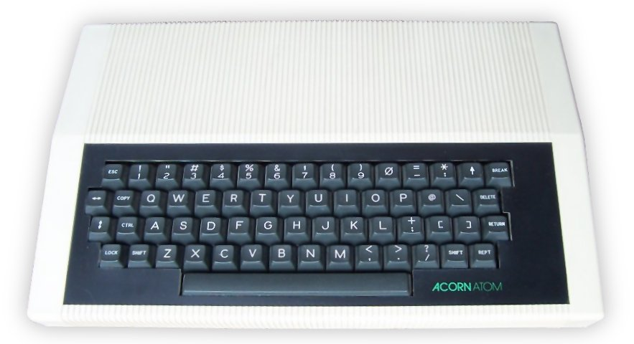
My first computer

Slide 3
ARM
ARM is a great company,
if ARM produces the IP you need,
& if you and ARM can work out a licence agreement in time,
then you’d be crazy not to use ARM,
but many projects don’t fit into above
(and some people are just crazy)

Slide 4
ISAs don’t matter
Most of the performance and energy of a computer is due to:
Algorithms
Application code
Compiler
ISA
Microarchitecture (core + memory hierarchy)
Circuit design
Physical design
Fabrication process

Slide 5
ISAs do matter
Most important interface in a computer system
Large cost to port and tune all ISA‑dependent parts of a modern software stack
Large cost to port/QA all supposedly ISA‑independent parts of a modern software stack

Slide 6
So…
If choice of ISA doesn’t have much impact on system energy/performance,
and it costs a lot to use different ones,
why isn’t there just one industry-standard ISA?

Slide 7
ISAs Should Be Free and Open
While ISAs may be proprietary for historical or business reasons, there is no good technical reason for the lack of free, open ISAs:
It’s not an error of omission.
Nor is it because the companies do most of the software development.
Neither do companies exclusively have the experience needed to design a competent ISA.
Nor are the most popular ISAs wonderful ISAs.
Neither can only companies verify ISA compatibility.
Finally, proprietary ISAs are not guaranteed to last.

Slide 8
Benefits from Viable Freely Open ISA
Greater innovation via free-market competition from many core designers.
Shared open core designs, which would mean shorter time to market, lower cost from reuse, fewer errors given many more eyeballs, and transparency that would make it hard, for example, for government agencies to add secret trap doors.
Processors becoming affordable for more devices, which would help expand the Internet of Things (IoTs), which could cost as little as $1.

Slide 9
Existing ISAs Offer a Good Start
SPARC V8 - To its credit, Sun Microsystems made SPARC V8 an IEEE standard in 1994.
OpenRISC - This GNU open-source effort started in 2000, with the 64-bit ISA being completed in 2011.
RISC-V - In 2010, partly inspired by ARM’s IP restrictions and the lack of 64-bit addresses and overall baroqueness in ARMv7, we developed RISC-V (pronounced “RISK-5”) for our research and classes, and made it BSD open source.

Slide 10
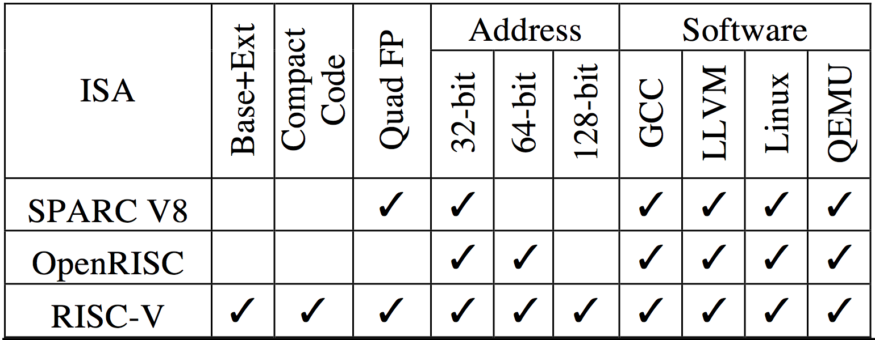
Ranking Free, Open RISC ISAs:
RISC-V Meets All Requirements
Key Requirements
  Simple!!!
  Base-plus-extension ISA
  Compact instruction set encoding
  Quadruple-precision (QP) as well as SP and DP floating-point
  128-bit addressing as well as 32-bit and 64-bit

Slide 11
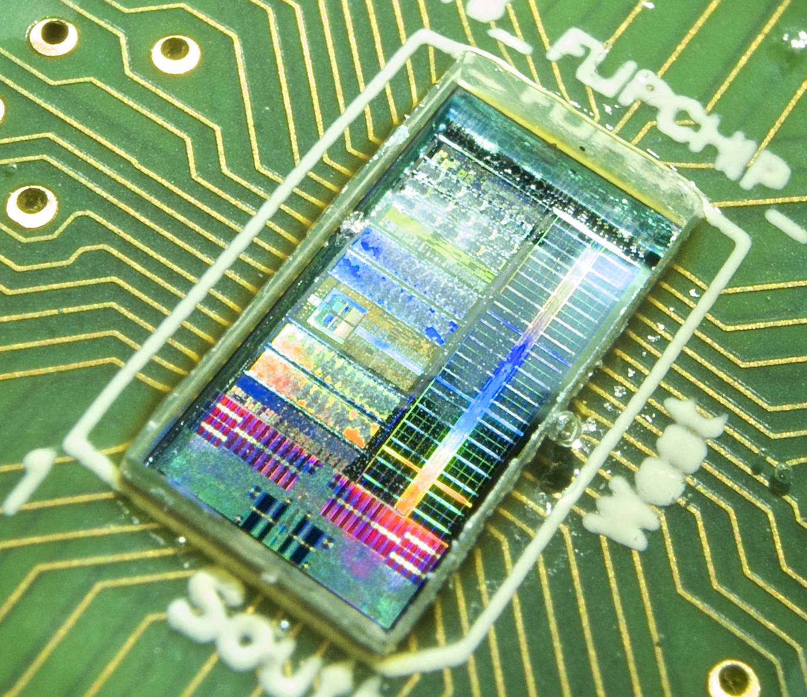
EOS Chip Roadmap in IBM 45nm SOI
(design/fabrication funded by DARPA PERFECT/POEM)
Chip | Tapeout | Receipt | DP GF/W | Notes
EOS14 | Mar’12 | Sep’12 | 5.0 | “ESP-0” Rocket + Hwacha vector unit. First “Chisel”-ed RISC-V core.
EOS16 | Aug’12 | Mar’13 | — | Dual-core cache-coherent Rocket + Hwacha. Broken pad drivers, IBM’s bug.
EOS18 | Feb’13 | Jul’13 | 16.7 | Dual-core cache-coherent Rocket + Hwacha. QoR improvements: dual VT flow; hierarchical P&R; RTL improvements for dynamic power & clock rate
EOS20 | Jul’13 | Jan’14 | 14.1 | Dual-core design from ESP-1 chip generator. Multi-VT flow. Runs Linux. Raven-3 from same RTL.
EOS22 | Mar’14 | ?? |  | EOS20 + bug fixes + faster FPU
EOS24 | Nov’14 | ?? |  | Initial version of ESP-2; FireBox chip prototype

Slide 12
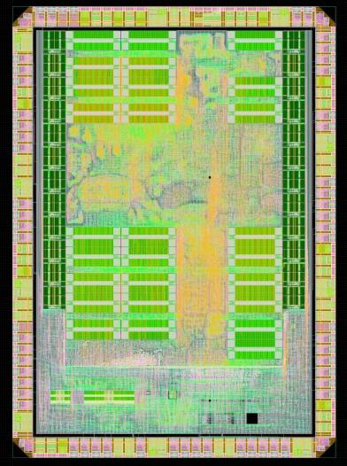
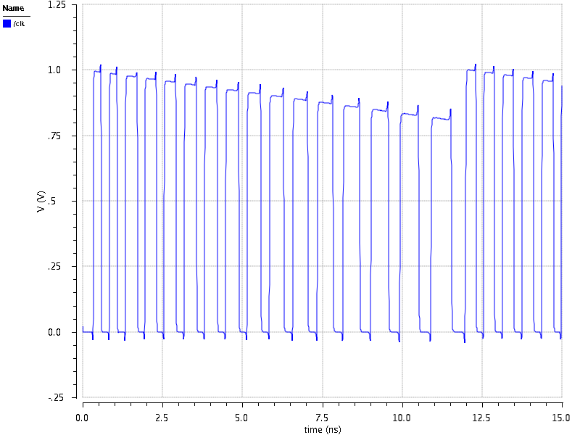
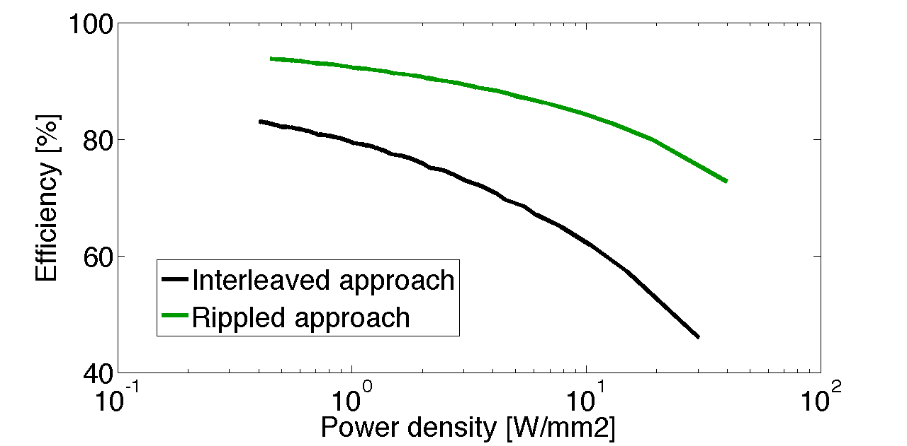
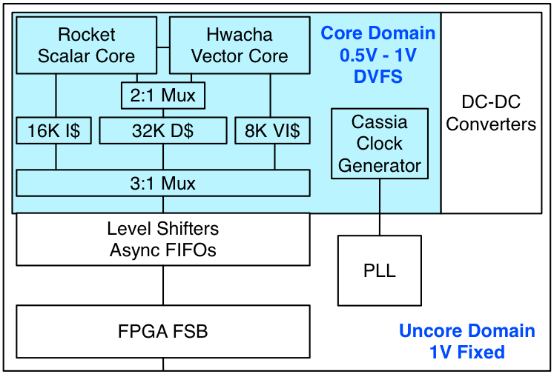
Raven-3 Architecture in 28nm FDSOI
(Resilient Architecture with Vector-thread ExecutioN)
Single 64-bit RISC-V Rocket core plus vector unit (ESP-1)
Resilient SRAM with assists for low voltage operation
Integrated switched-cap DC/DC, no output regulation
Adaptive clocking following DC supply ripple
Vector
RF
VI$
DC-DC
Rocket/Hwacha
Tile
D$
I$
Clock gets slower as V_{DCDC} decreases.
BIST
Uncore
5%
5%
PD=2.78
PD=0.46
PD=1.43

Slide 13
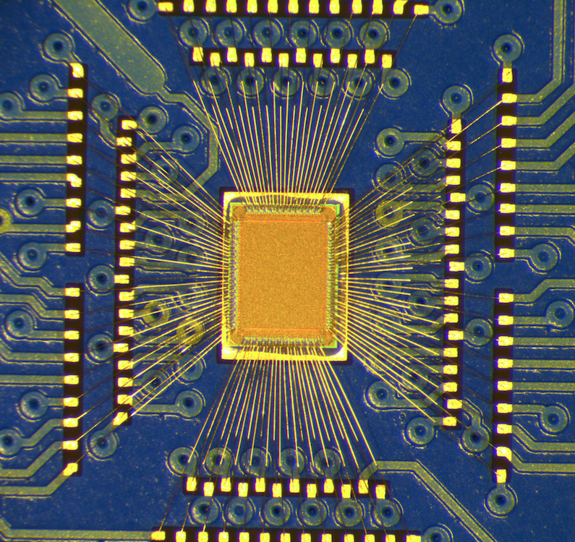
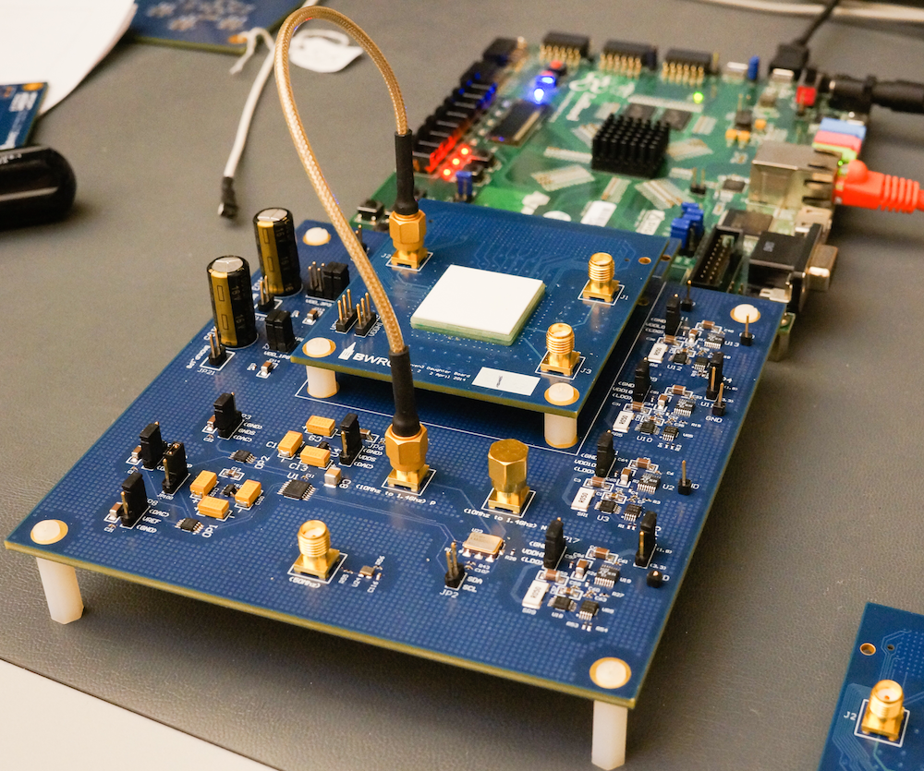
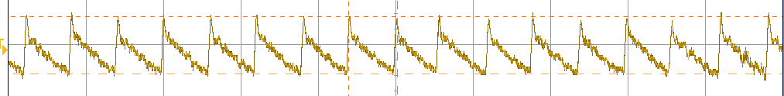
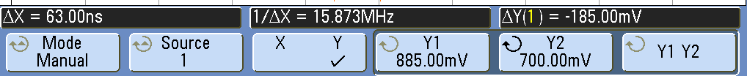
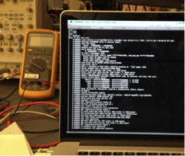
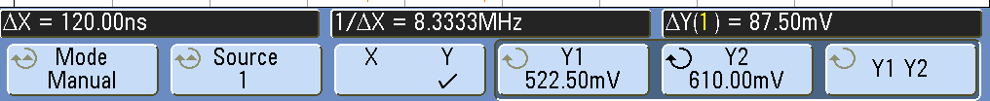
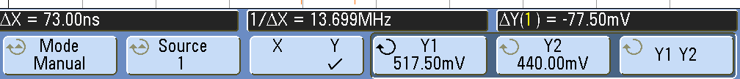
Raven-3 Preliminary Measurements
Boots Linux, runs Python, up to 970MHz
All 3 DC-DC configurations work, down to 0.45V
  >30GFLOPS/W running DGEMM 64-bit fused mul-adds
Next:
Raven-3.5, fall 2014: add body-bias control, improve QoR, improve instrumentation
Raven-4, 2015?: ESP-2 quad-core with many independent supplies
Conf. 1
Conf. 2
Conf. 3

Slide 14
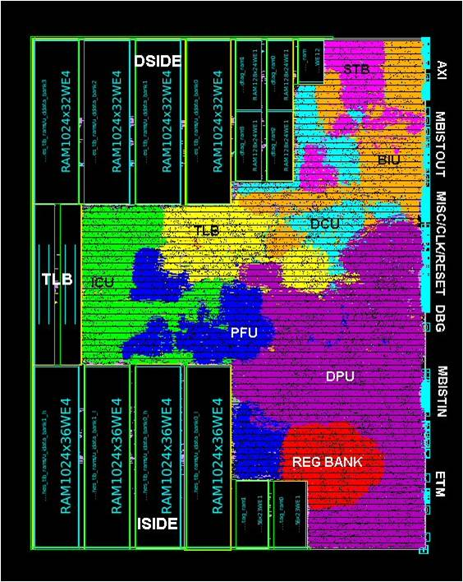
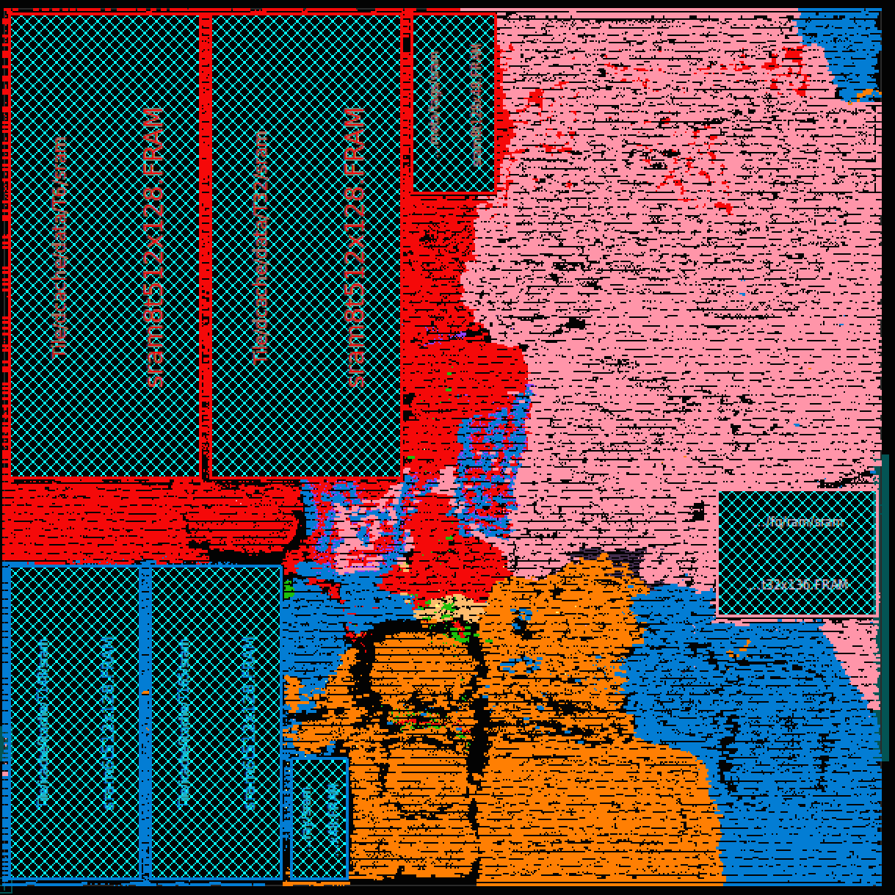
ARM Cortex A5 vs. RISC-V Rocket
Category | ARM Cortex A5 | RISC-V Rocket
ISA | 32-bit ARM v7 | 64-bit RISC-V v2
Architecture | Single-Issue In-Order | Single-Issue In-Order 6-stage
Performance | 1.57 DMIPS/MHz | 1.72 DMIPS/MHz
Process | TSMC 40GPLUS | TSMC 40GPLUS
Area w/o Caches | 0.27 mm^2 | 0.14 mm^2
Area with 16K Caches | 0.53 mm^2 | 0.39 mm^2
Area Efficiency | 2.96 DMIPS/MHz/mm^2 | 4.41 DMIPS/MHz/mm^2
Frequency | >1GHz | >1GHz
Dynamic Power | <0.08 mW/MHz | 0.034 mW/MHz
Rocket Area Numbers
Assuming 85% Utilization,
the same number ARM
used to report area.
Plots are not to scale.

Slide 15
RISC-V Ecosystem www.riscv.org
Documentation
  User-Level ISA Spec v2
  Reviewing Privileged ISA
Software Tools
  GCC/glibc/GDB
  LLVM/Clang
  Linux
  Verification Suite
Hardware Tools
  Zynq FPGA Infrastructure
  Chisel
Software Implementations
  ANGEL, JavaScript ISA Sim.
  Spike, In-house ISA Sim.
  QEMU
Hardware Implementations
  Rocket Core Generator
    RV64G single-issue in-order pipe
  Sodor Processor Collection

Slide 16
RISC-V External Users
India has started an extensive program at IIT-Madras for development of a complete range of processors, ranging from micro-controllers to server/HPC grade processors.
The lowRISC project’s goal is to produce open-source RISC-V based SoCs. The project is based in UK led by one of the founders of Raspberry Pi.
Bluespec in the US has customers interested in an Open ISA, so they are implementing RISC-V designs in their synthesis toolset.

Slide 17
For More Information
For more information on RISC-V, access www.riscv.org.
The first RISC-V workshop and boot camp will be held January 14-15, 2015 in Monterey, CA; see www.regonline.com/riscvworkshop for more information.
Details on IIT’s RISC-V project are at rise.cse.iitm.ac.in/shakti.html. Information on other RISC-V projects can be found at lowrisc.org and bluespec.com.

Slide 18
Chisel: Constructing Hardware In a Scala Embedded Language
Embed hardware-description language in Scala, using Scala’s extension facilities: Hardware module is just data structure in Scala
Different output routines generate different types of output (C, FPGA-Verilog, ASIC-Verilog) from same hardware representation
Full power of Scala for writing hardware generators
  Object-Oriented: Factory objects, traits, overloading etc
  Functional: Higher-order funcs, anonymous funcs, currying
  Compiles to JVM: Good performance, Java interoperability
Chisel Program
Chisel 2.2.12/13 releases
Lots of bug fixes and speedups
Parameterization support
Improved tester facilities
Fixed-point and complex numeric support
Tagged unions and typed enums
BSD-licensed open source at:
  chisel.eecs.berkeley.edu
Scala/JVM
C++ code
FPGA Verilog
ASIC Verilog
C++ Compiler
FPGA Tools
ASIC Tools
Chisel 3.0 plans:
RTL Graph IR (“LLVM for hardware”)
Bridge in/out of LLVM IR
Software Simulator
FPGA Emulation
GDS Layout

Slide 19
ESP Chip Generator
Parameterized multiprocessor SoC generator in Chisel
ESP-1 vector baseline for Phase-I
ESP-2 pattern-specific extensions for Phase-II (ESP-3 in Phase-III)
Current ESP-1 SoC generator includes:
  “Rocket” RISC-V processors (64-bit single-issue in-order decoupled processors with IEEE-754/2008 FPU and MMU)
  ROcket Custom Coprocessor (ROCC) interface on each core
    Tightly coupled accelerator interface
    Add “Hwacha” vector units or other custom accelerators
  Cache-coherent memory system
    Private L1/L2 caches plus outer shared L3 cache
  DRAM controller and DRAM subsystem
  Host-target interface to tether to control system
Software stack including Linux, GCC/binutils, LLVM
Used in multiple subprojects to generate chips, FPGA emulations, and/or C++ simulations
See www.riscv.org for details on RISC-V open ISA and tools
  Final RISC-V user-level ISA V2.0 frozen

Slide 20
FireBox Rack
Processor Module
SoC
CPU
Vectors ++
Up to 1000 Modules of all kinds:
SoC, DRAM, Flash
NIC
CPU
Vectors ++
NIC
CPU
Vectors ++
NIC
Secret
Sauce
Private $/VLS
Private $/VLS
Private $/VLS
DMA
DMA
DMA
Crypt/Compress
Switch
DRAM Module
Switch
Chip
Shared $/VLS
Switch
Chip
Up to 4Pb/s
network
Switch
Chip
HiBW DRAM
Flash Module
Bulk DRAM Control
DRAM
Redundancy for
Dependability
DRAM
DRAM
DRAM
DRAM
DRAM
DRAM
DRAM
Flash Control
Flash
Flash
Flash
Flash
Flash
Flash
Flash
Flash

Slide 21
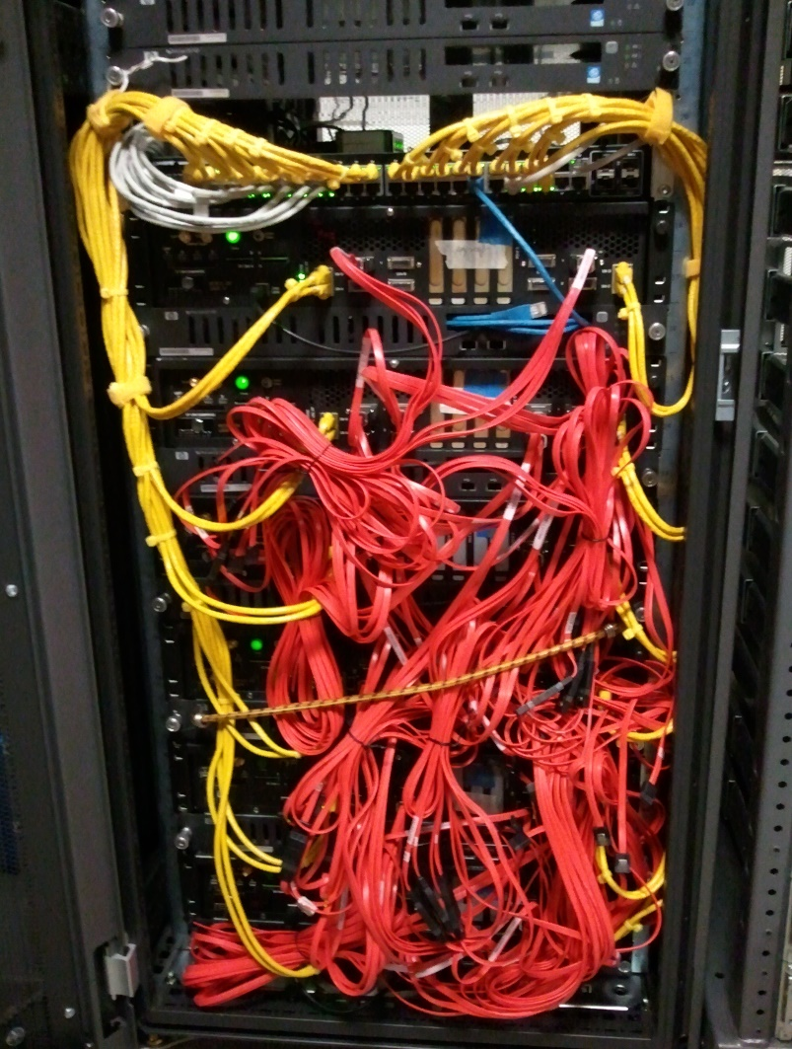
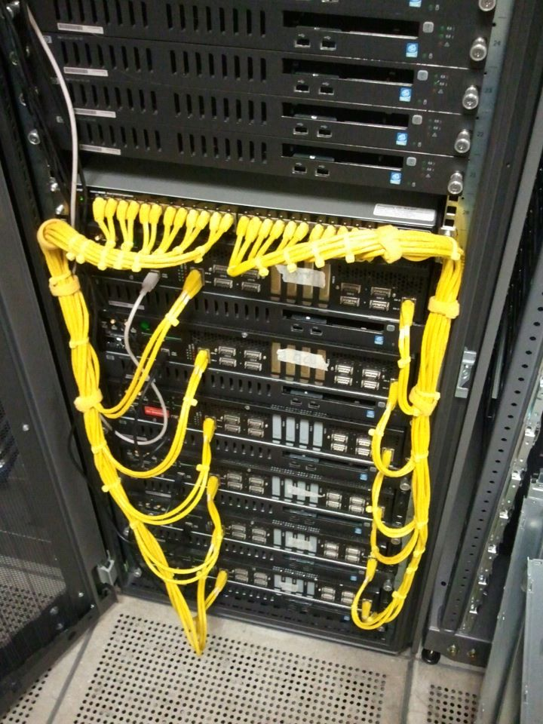
DIABLO 1 Cluster Prototype
6 BEE3 boards total 24 Xilinx Virtex5 FPGAs
  Physical characteristics:
    Full-custom FPGA implementation with many reliability features @ 90/180 MHz
    Memory: 384 GB (128 MB/node), peak bandwidth 180 GB/s
    Connected with SERDES @ 2.5 Gbps
    Host control bandwidth: 24 x 1 Gbps control bandwidth to the switch
    Active power: ~1.2 kWatt
  Simulation capacity
    3,072 simulated servers in 96 simulated racks, 96 simulated switches
    8.4 B instructions / second
Notes:
The cables are basically manually connected according to the real physical topology. This is also how I scale up the system.
Cable (or topology) is one parameter that people can change in DIABLO.
This also explains why we need to build a new HW for DIABLO. The original model for BEE3 is to connect to a CX4 switch....

Slide 22
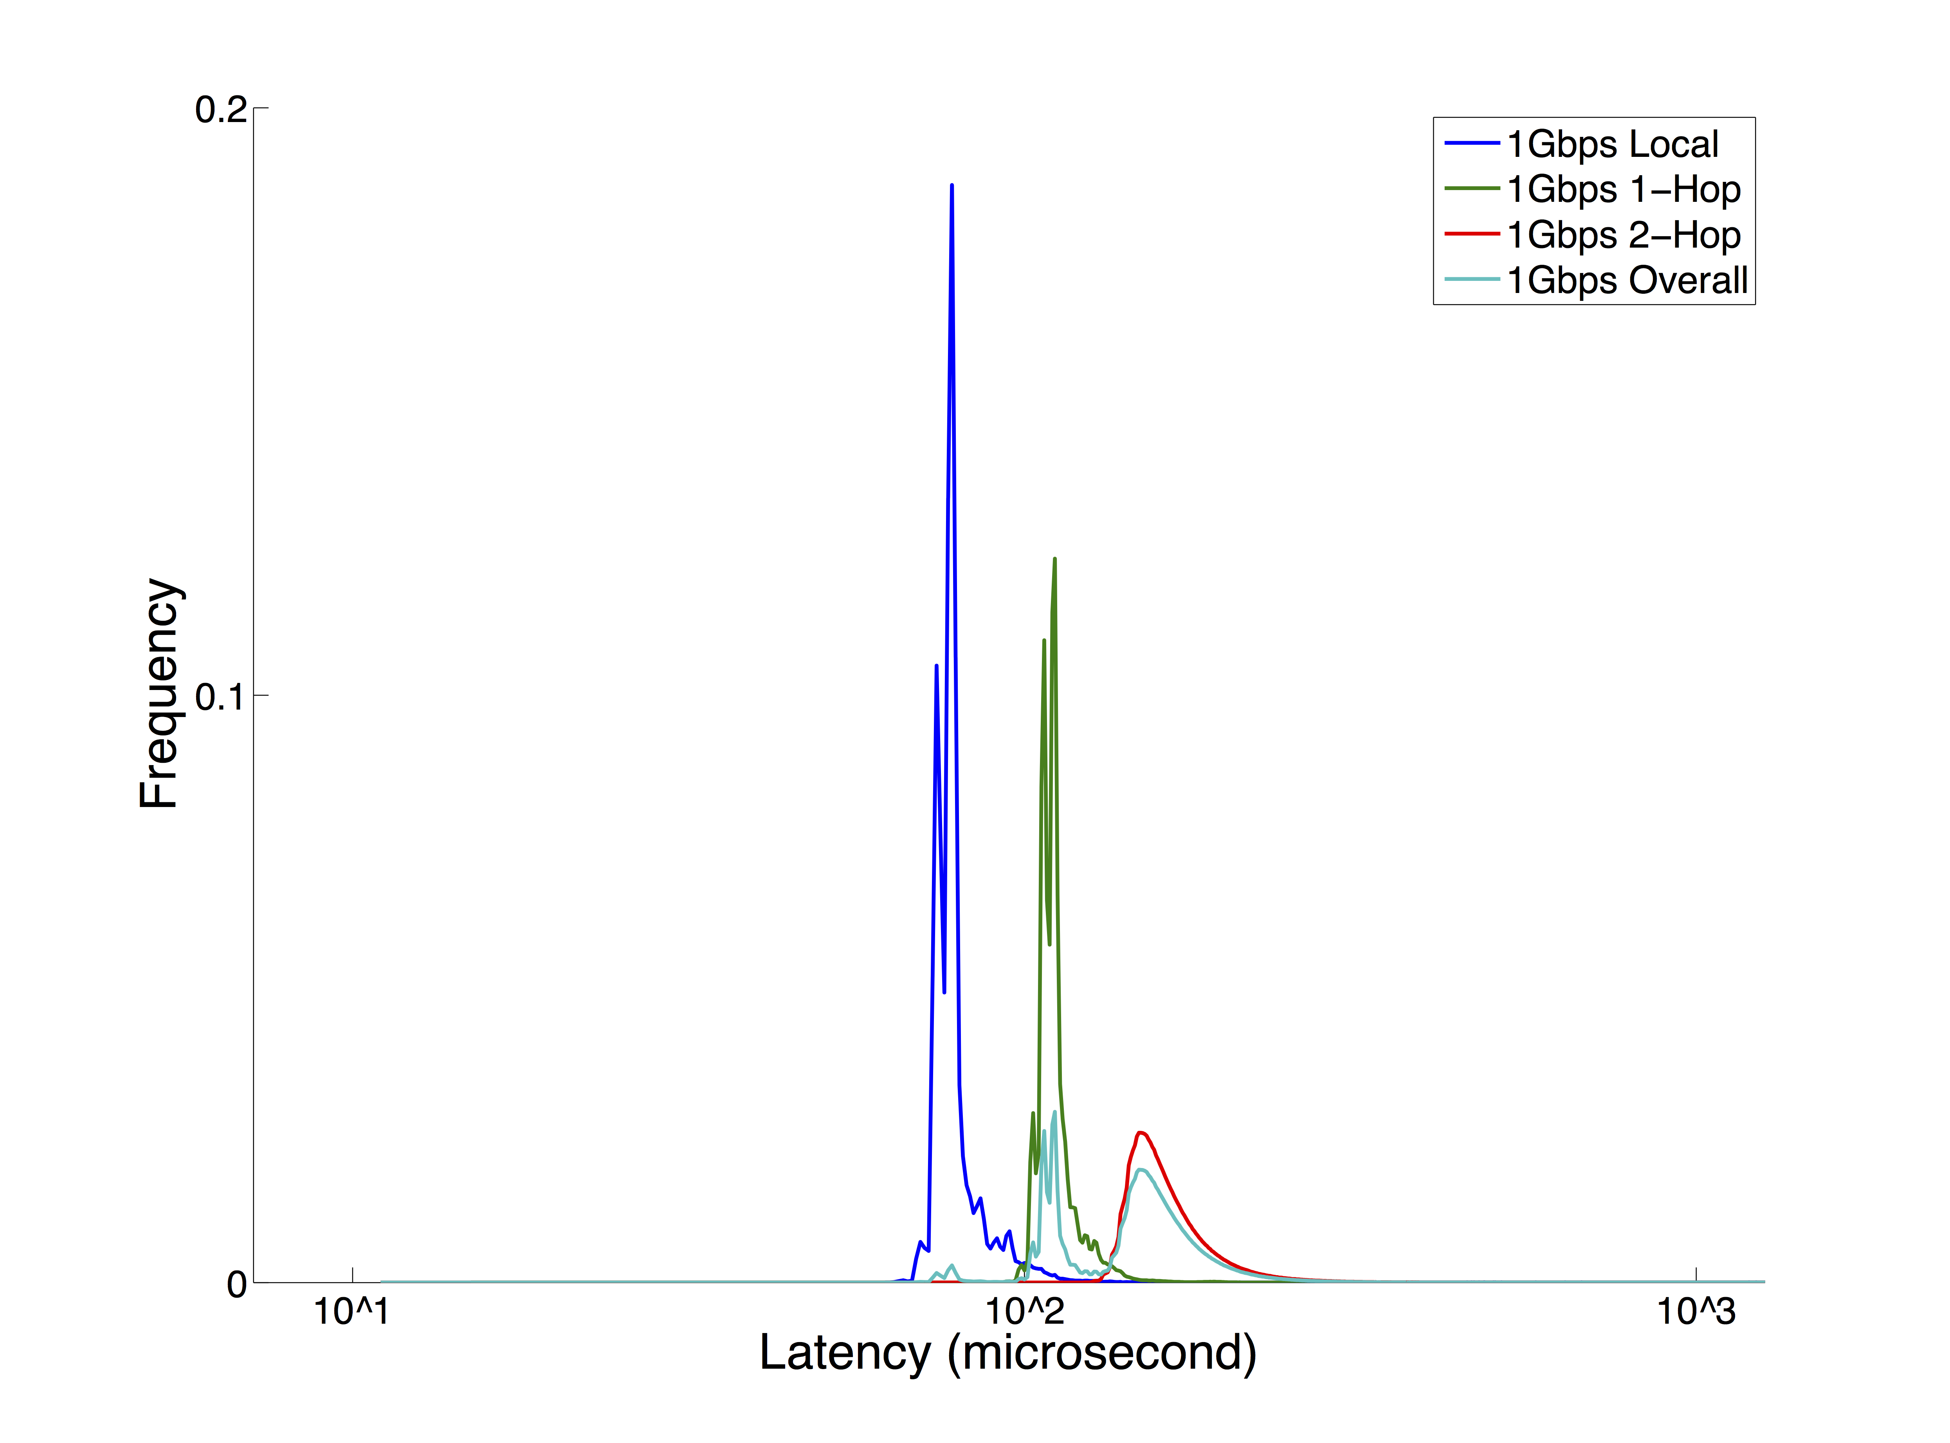
Reproducing memcached latency long tail at 2,000-node scale with DIABLO
Most requests complete ~100µs, but some 100x slower
More switches -> greater latency variations
  [ Luiz Barroso “Entering the teenage decade in warehouse-scale computing” FCRC’11 ]

Slide 23
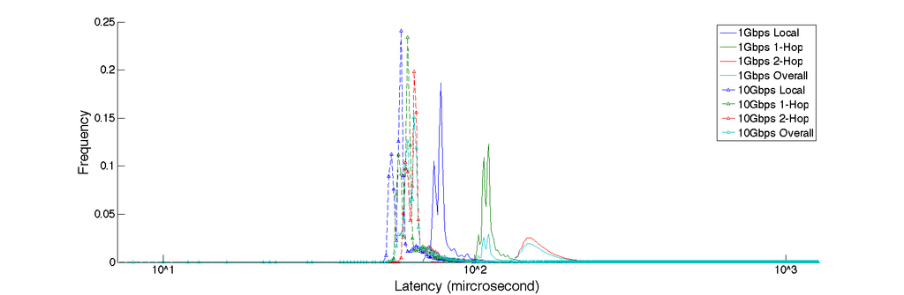
Adding 10x Better Interconnect
10 Gbps
1 Gbps
Low-latency 10Gbps switches improve access latency but only <2x
The software stack dominates!

Slide 24
Impact of kernel versions on 2,000-node memcached latency long tail
Better implementations in newer kernel helps the latency long tail

Slide 25
HPC widgets
Ordered from innermost to outermost relative to core:
Extended arithmetic support
  Long/exact floating-point, short/long integer/fixed-point
Vector unit plus extensions
  Convolution, FFT, Sort
(Virtual) Local store plus DMA
  Copy in/out with different addressing patterns
Integrated low-overhead NIC
  RPC, one-sided operations
Processing-in-memory (?)

Slide 26
How to NOT build an HPC-SoC
Define specification up front with community input and extensive application simulation and tuning
Base architecture on a big new idea
Fund only one big chip/system spin
Give money to group who haven’t built a chip or system before
Give money to a big company
Distribute money over N sites
Judge funding on research paper output
Have review/funding ratio of >1/$100K

Slide 27
ASPIRE Sponsors
DARPA PERFECT program
DARPA POEM program (Si photonics)
STARnet Center for Future Architectures (C-FAR)
Lawrence Berkeley National Laboratory
Industrial sponsors
  Intel
Industrial affiliates
  Google
  Huawei
  Nokia
  NVIDIA
  Oracle
  Samsung

