Slide 1
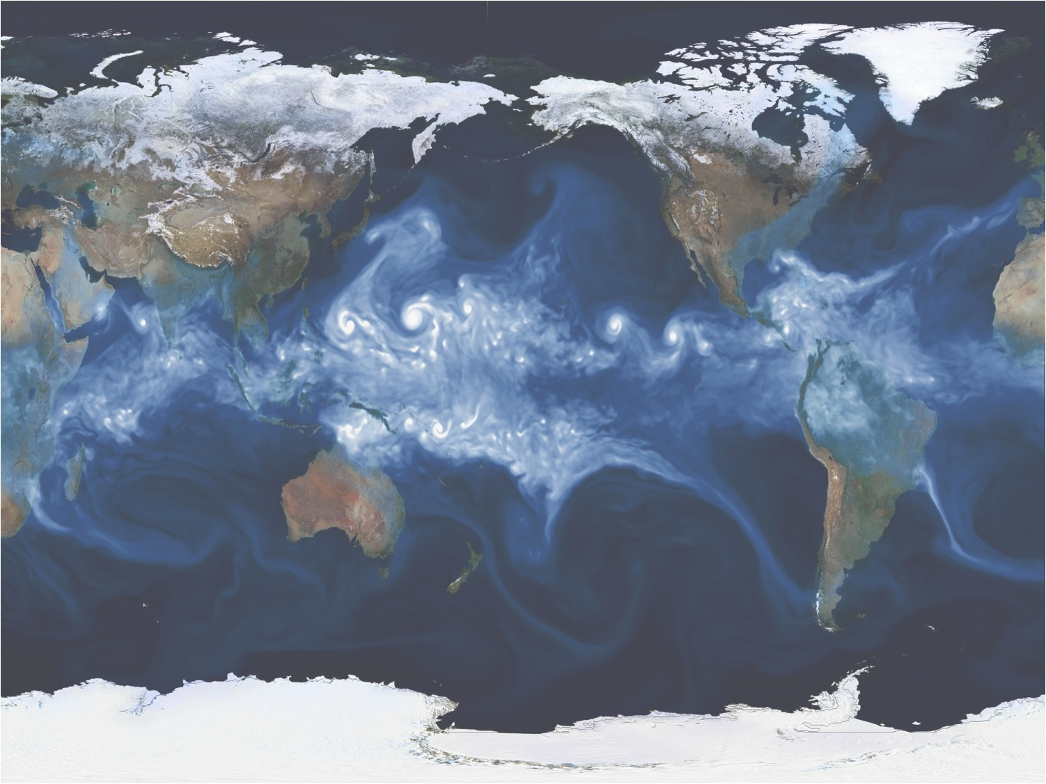
Exascale climate modeling
24th International Conference on Parallel Architectures and Compilation Techniques
October 18, 2015
Michael F. Wehner
Lawrence Berkeley National Laboratory
mfwehner@lbl.gov

Slide 2
Why exascale climate modeling?
We already understand the climate system well enough to know that policies to reduce greenhouse gas emissions are critical to the well-being of the human race.

Slide 3
Why exascale climate modeling?
But the science is not “done and dusted”!
There are many remaining questions:
  Clouds and their feedbacks remain a critical weakness in determining the sensitivity of the climate system to increases in carbon dioxide.
  All climate change impacts are local…
    What will happen where I live?
    We need much finer scale information about changes in temperature, precipitation and winds.
    Especially extreme weather events.

Slide 4
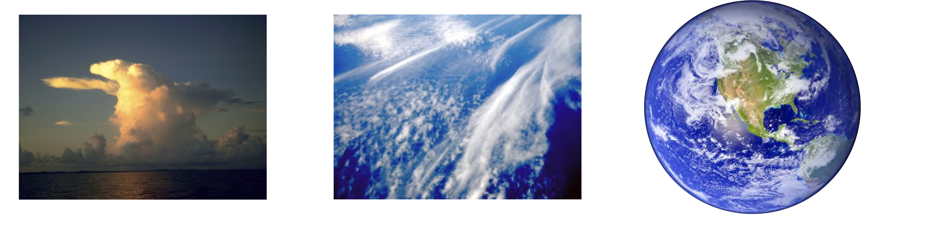
Global Cloud System Resolving Climate Modeling
Individual cloud physics fairly well understood
Parameterization of mesoscale cloud statistics performs poorly.
Direct simulation of cloud systems in global models requires exascale!
At resolutions of ~1km, atmospheric models are cloud permitting.
  Or better described as “cloud system resolving”
  We can then replace parameterized cumulus convection with direct numerical simulation.
Notes:
Climate modelers indicate that cloud models are key source of error
High resoution, 1km scale model will address this problem using physical cloud models
At current resolutions, cloud statistics must be parameterized.
After 30 years, there are still major issues with parameterization
Physics of individual cloud systems is well understood
Cloud system resolving models can explicitly simulate these statistics
Requires 1km resolution
10⁷ times more computer cycles
UN WMO Climate Modeling Summit cites as the top priority

Slide 5
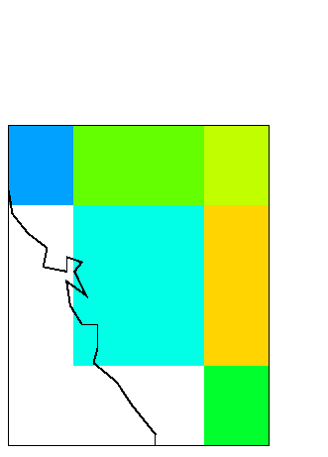
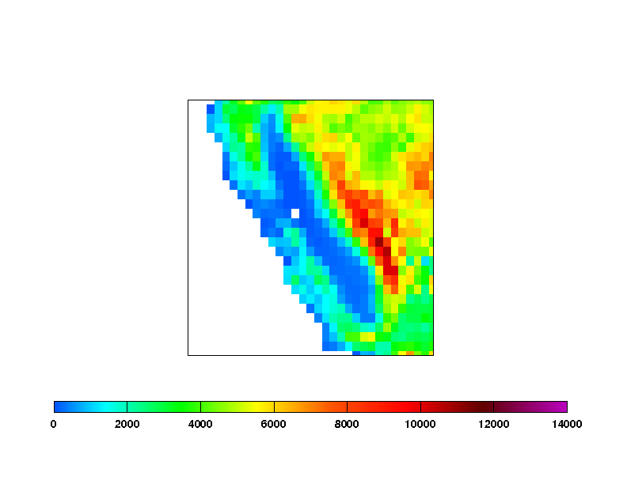
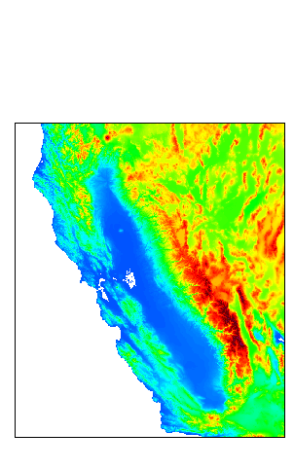
Global Cloud System Resolving Models will be a Transformational Change
Surface Altitude (feet)
200km
Typical resolution of IPCC AR4 models
25km
Upper limit of climate models with cloud parameterizations
1km
Cloud system resolving models

Slide 6
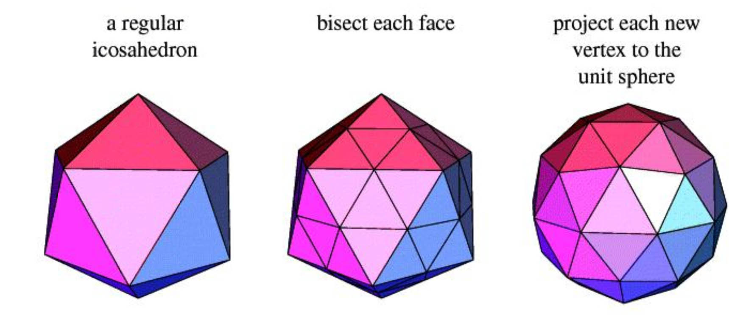
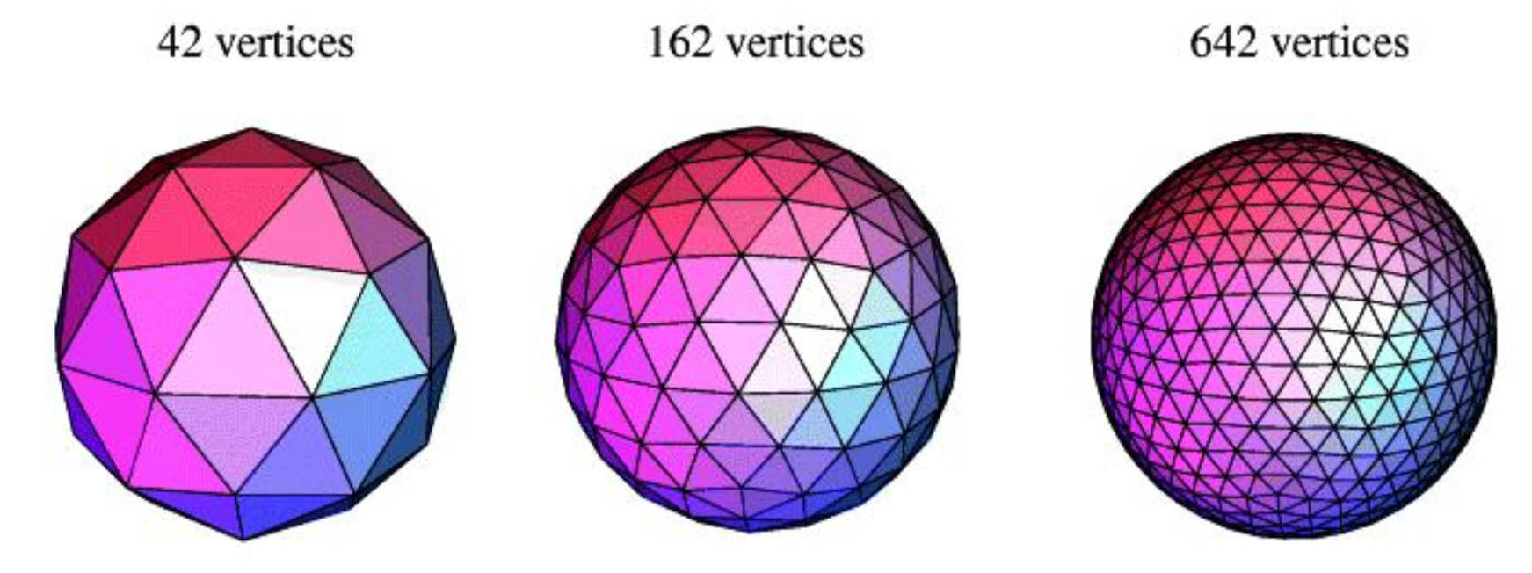
The CSU icosahedral atmospheric model
Consider a target resolution is 167,772,162 vertices, ~128 vertical levels, ~1.75 km
This is not the only strategy!
Ross Heikes CSU
Notes:
Mention cubed sphere here. We know that climate projections are better if multiple models are used. One climate model’s code requirements are different from another climate model, but they are more alike than different. Models from other disciplines like nanotechnology or protein folding are very different. Part of our approach is to exploit this similarity.

Slide 7
Code Requirements Model
Measure and extrapolate:
  Operation count
  Main memory footprint
  Cache memory footprint
  Memory bandwidth (bytes/flop)
  Instruction mix
  Interconnect bandwidth
  Interconnect latency
  Interconnect topology
Derived constraints
  Power (core + memory+interconnect)
  Pins (memory + interconnect)
  Mix of instruction in hardware (Flops, integer ops , branch, etc)
Wehner et al. (2011) Hardware/Software Co-design of Global Cloud System Resolving Models. Journal of Advances in Modeling Earth Systems 3, M10003, DOI:10.1029/2011MS000073

Slide 8
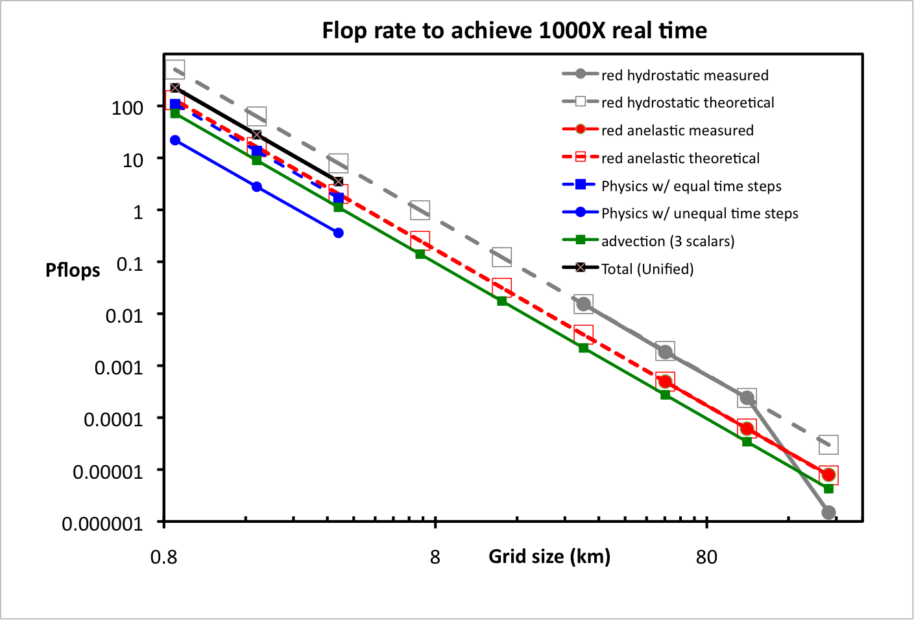
Computational rate
28Pflops sustained to integrate the CSU GCSRM at 1000 times faster than actual time.

Slide 9
Total memory
1.8PB at the target resolution

Slide 10

Nested levels of parallelism
A strategy to achieve 28 sustained petaflops on many core chip systems.
Standard 2 dimensional domain decomposition
Blue: A subdomain of NxN grid points assigned to a single core.
Red: A super-subdomain of MxM subdomains on a single chip
Blue communication is fast, on-chip.
Red communication is off-chip, on the network.
.

Slide 11
The LBNL strawman exascale climate model
At 2km in the horizontal (level 12) and 128 vertical levels.
21 Billion computational grid points.
  2,621,440 horizontal subdomains (8x8 cells)
  8 vertical subdomains of 16 levels each (or 8x8x16 cells per subdomain)
    =20,971,520 total physical subdomains.
Extrapolating the measured CSU computational and communication requirements, to run the 2km model 1000X faster than real time requires:
    20,971,520 processor cores
    1.3 sustained Gflops/core (28Pflops total)
    256KB/core cache
    200,000 msg/sec latency
    If we have 128processor cores per chip technology:
    163,840 chips
    4x4x8 subdomains/chip: 9.2GB/sec nearest neighbor off-chip bandwidth
    If we have 512 processor cores per chip technology:
    40,960 chips
    8x8x8 subdomains/chip: 37GB/sec nearest neighbor off-chip bandwidth

Slide 12
We believe that this is technologically feasible.
Today.

Slide 13
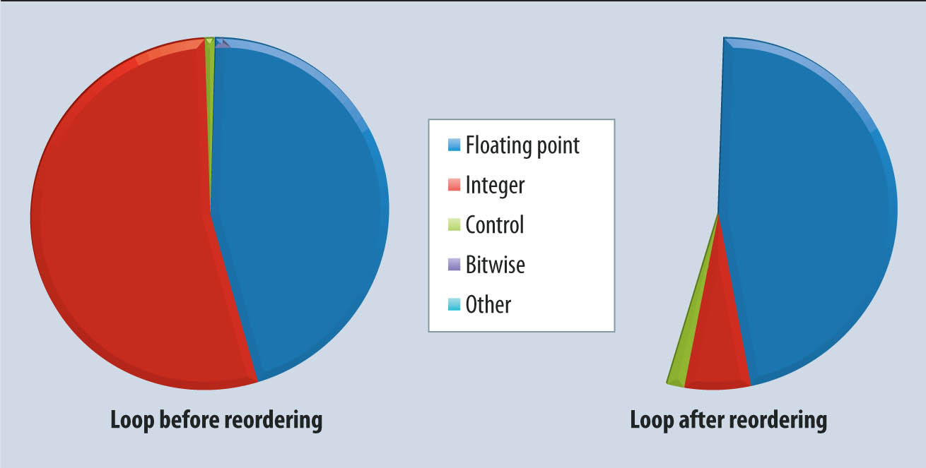
Feasibility
20,971,520 processor cores sustaining 1.3Gflop apiece.
1.3Gflop = ~2.5% of theoretical peak for the Knights Landing core.
  About as efficient as contemporary climate models. Sadly.
Such rates would require an exaflop machine.
But a 3X improvement in efficiency may permit such simulations on the 300Pflop Aurora machine planned for Argonne National Laboratory.
  Auto-tuning would help achieve this.
  And subject to different domain decomposition details.
Auto-tuning reduced instruction count in the CSU buoyancy loop by a factor of two by reducing overhead costs.
Notes:
Note: even without the 3x speedup, execution time would be the same as 25km on hopper!

Slide 14
  More about Aurora
At 2km, we estimate that a single year requires 10²¹ floating point operations*
On Aurora (2019): at ~3% of peak efficiency, this will take 1 day.
  The same rate that I am running 25km today (albeit limited by scaling issues).
  There is more than enough parallelism at this resolution to use the entire machine.
What are the data implications?
  Can we output the data we need?
  Can we store the data we need?
  Can we still analyze off-line?
These are answerable questions.
Resist jumping to conclusions.
Do the math.
*Based on the CSU icosahedral model. Wehner et al. (2011) JAMES 3, M10003,
DOI:10.1029/2011MS000073

Slide 15
  More about Aurora
At 2km, we estimate that a single year requires 10²¹ floating point operations*
On Aurora (2019): at ~3% of peak efficiency, this will take 1 day.
  The same rate that I am running 25km today (albeit limited by scaling issues).
  There is more than enough parallelism at this resolution to use the entire machine.
What are the data implications?
  Can we output the data we need?
    Yes, for most analyses.
  Can we store the data we need?
    Yes, tape storage is adequate.
  Can we still analyze off-line?
    Yes, but some simple online preprocessing goes a long way.
These are answerable questions.
Resist jumping to conclusions.
Do the math.
*Based on the CSU icosahedral model. Wehner et al. (2011) JAMES 3, M10003,
DOI:10.1029/2011MS000073

Slide 16
Scalability
Our strawman design defined subdomains to contain 8x8x16 cells.
  Smaller than that could lead to communication bottlenecks.
Moving to the level 13 grid (~1km) and keeping this subdomain size means that per processor computational rates must double
  A result of the Courant stability criteria
  83,886,080 processor cores at 2.6Gflop
    225Pflops sustained

Slide 17
Closing thoughts
Ultra-high resolution climate modeling will require exascale computing
  And that may not be very far into the future!
Previously, we had put a lot of thought into hardware/software codesign.
  We advocated low-power, targeted architectures.
  Did this influence the design of the machines the DOE is purchasing?
Global cloud system resolving models may be feasible in two more generations of NERSC procurements.
  This would be aided by:
    More efficient algorithms to reduce floating point instructions.
    Auto-tuning to reduce non-floating point instruction count.
Notes:
That would be NERSC 10.

Slide 18
Thank You!
mfwehner@lbl.gov

